Slide 1


SK Richard Gallant State Warden State Webmaster Fourth Degree Exemplar
2025 Mid-Year Meeting
Website Update and Training
FloridaKnightsofColumbus@gmail.com (561) 707-5973

Slide 2
Agenda
Accessing and Using the Election of Delegates System
Accessing and Registering for the 2026 State Convention
The Use of the State Form 1728
Navigating Supreme Website for Resources
​
Richard Gallant | State Warden| Webmaster | Convention Registration | 4th Degree Exemplar
FloridaKnightsofColumbus@gmail.com | 561.707.5973

Slide 3
Accessing and Using the FSC 2026 State Convention Election of Delegates Page
Richard Gallant | District Deputy | Webmaster | Convention Registration | 4th Degree Exemplar
FloridaKnightsofColumbus@gmail.com | 561.707.5973

Slide 4
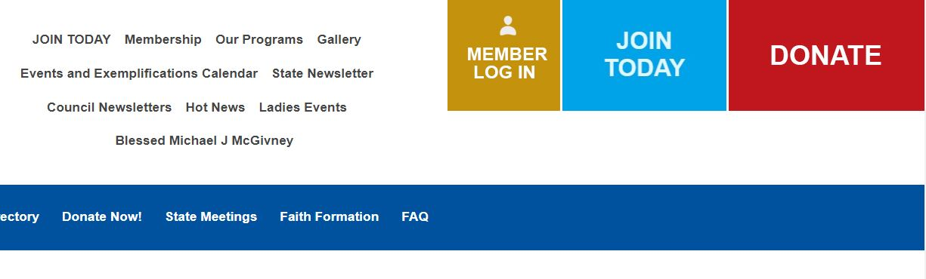
Log into the FloridaKofC.org website by clicking the gold “Member Log In” box located on the top of the home page.
Richard Gallant | District Deputy | Webmaster | Convention Registration | 4th Degree Exemplar
FloridaKnightsofColumbus@gmail.com | 561.707.5973

Slide 5
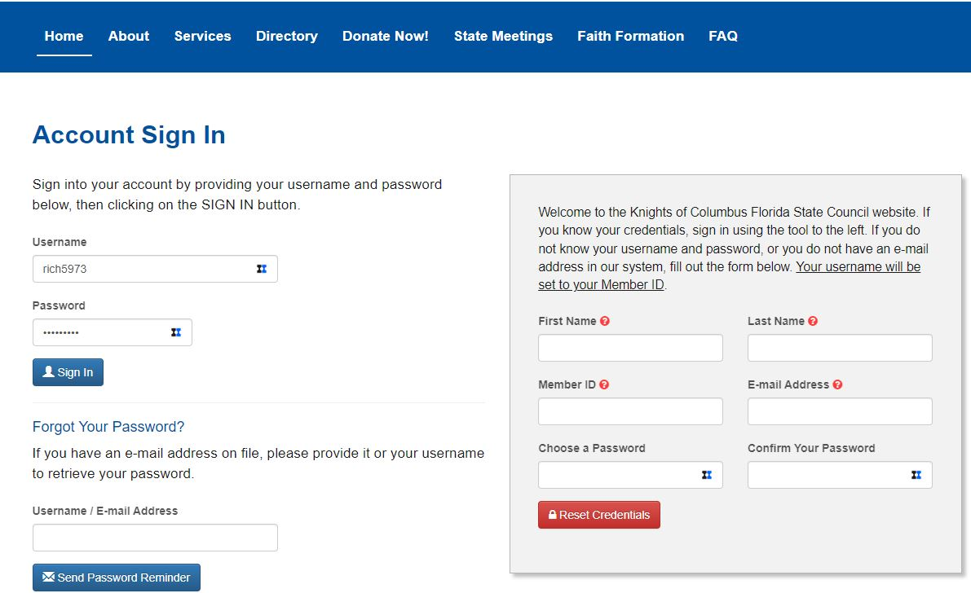
Richard Gallant | District Deputy | Webmaster | Convention Registration | 4th Degree Exemplar
FloridaKnightsofColumbus@gmail.com | 561.707.5973

Slide 6
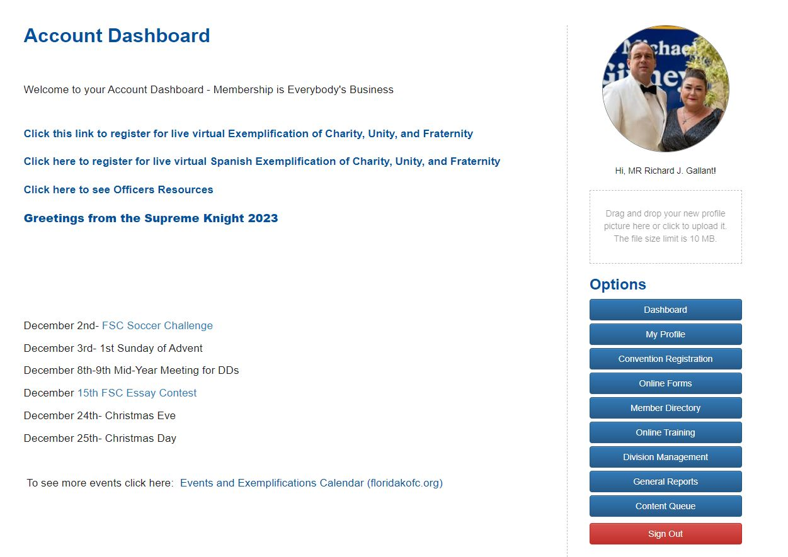
Richard Gallant | District Deputy | Webmaster | Convention Registration | 4th Degree Exemplar
FloridaKnightsofColumbus@gmail.com | 561.707.5973

Slide 7
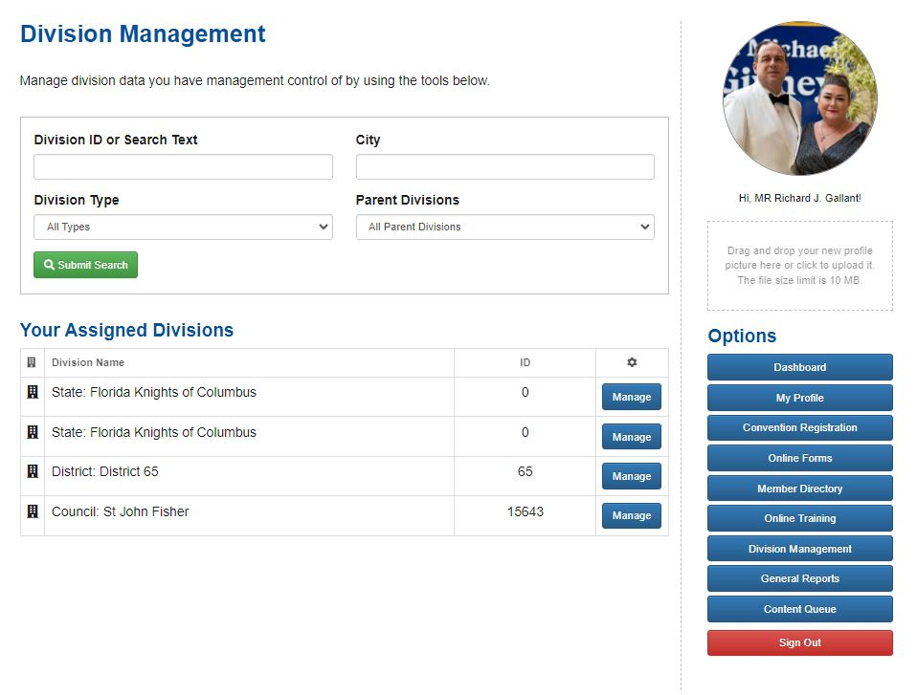
Richard Gallant | District Deputy | Webmaster | Convention Registration | 4th Degree Exemplar
FloridaKnightsofColumbus@gmail.com | 561.707.5973

Slide 8

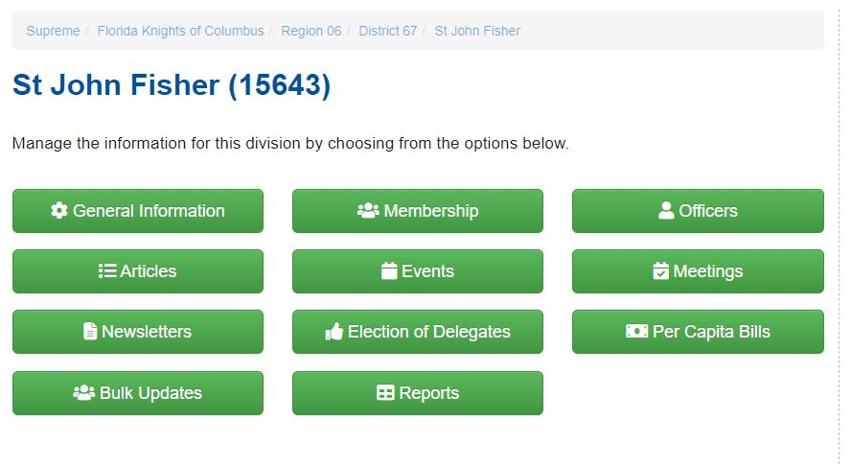
Richard Gallant | District Deputy | Webmaster | Convention Registration | 4th Degree Exemplar
FloridaKnightsofColumbus@gmail.com | 561.707.5973

Slide 9
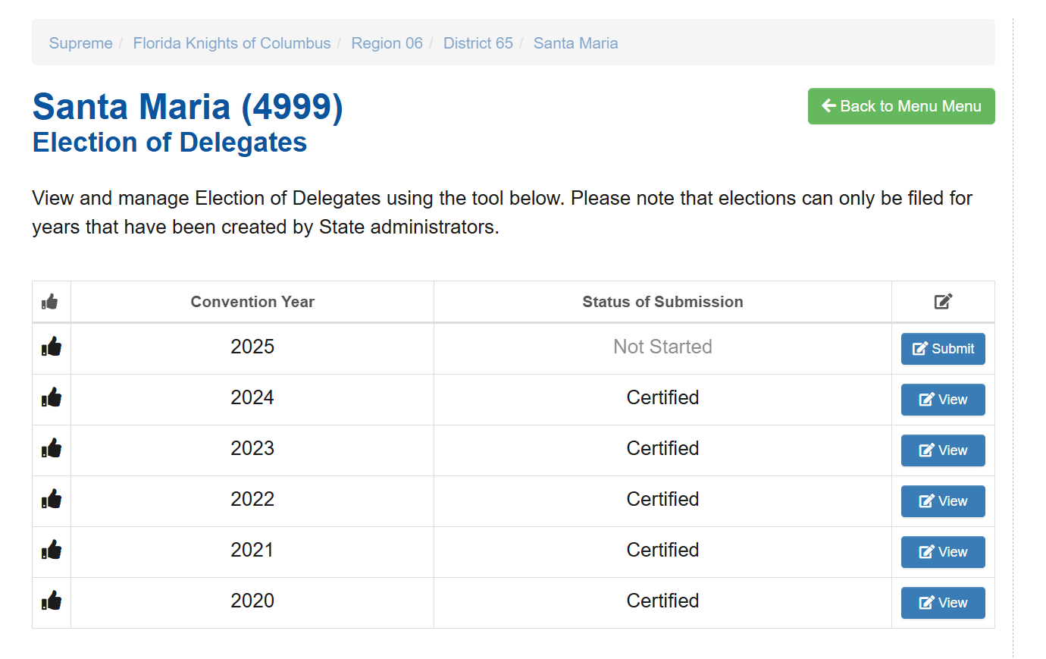
Richard Gallant | District Deputy | Webmaster | Convention Registration | 4th Degree Exemplar
FloridaKnightsofColumbus@gmail.com | 561.707.5973

Slide 10
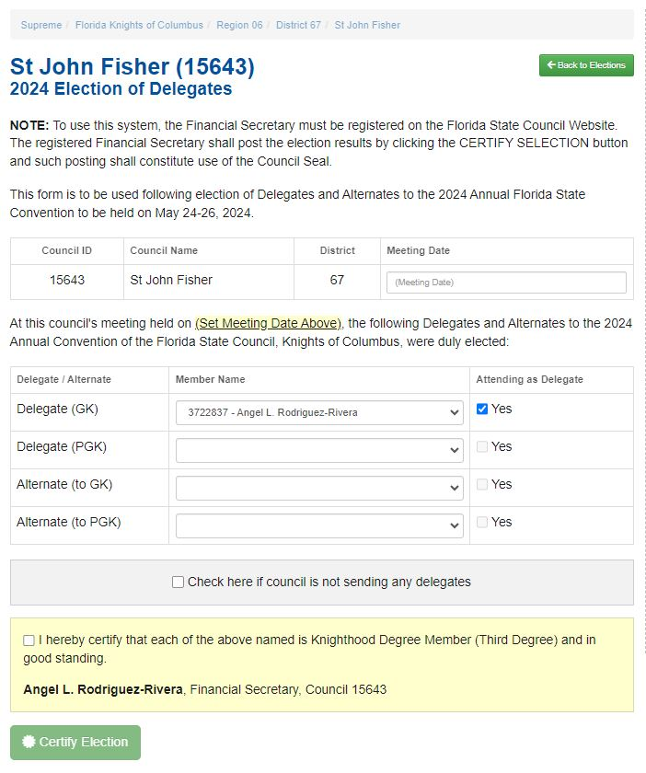
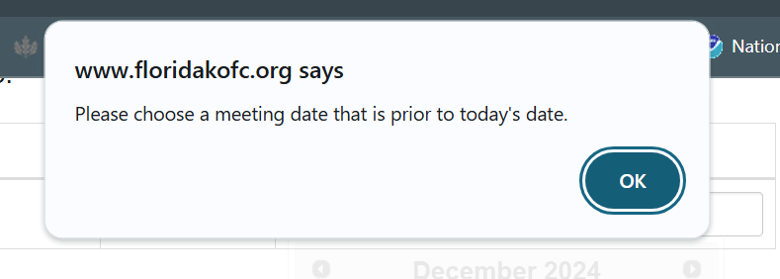
Meeting Date is required to be entered.
Delegates and Alternates must be voted on and that council meeting date be entered.
Meeting date is required to be before the date the Financial Secretary certifies the election.
Richard Gallant | District Deputy | Webmaster | Convention Registration | 4th Degree Exemplar
FloridaKnightsofColumbus@gmail.com | 561.707.5973

Slide 11
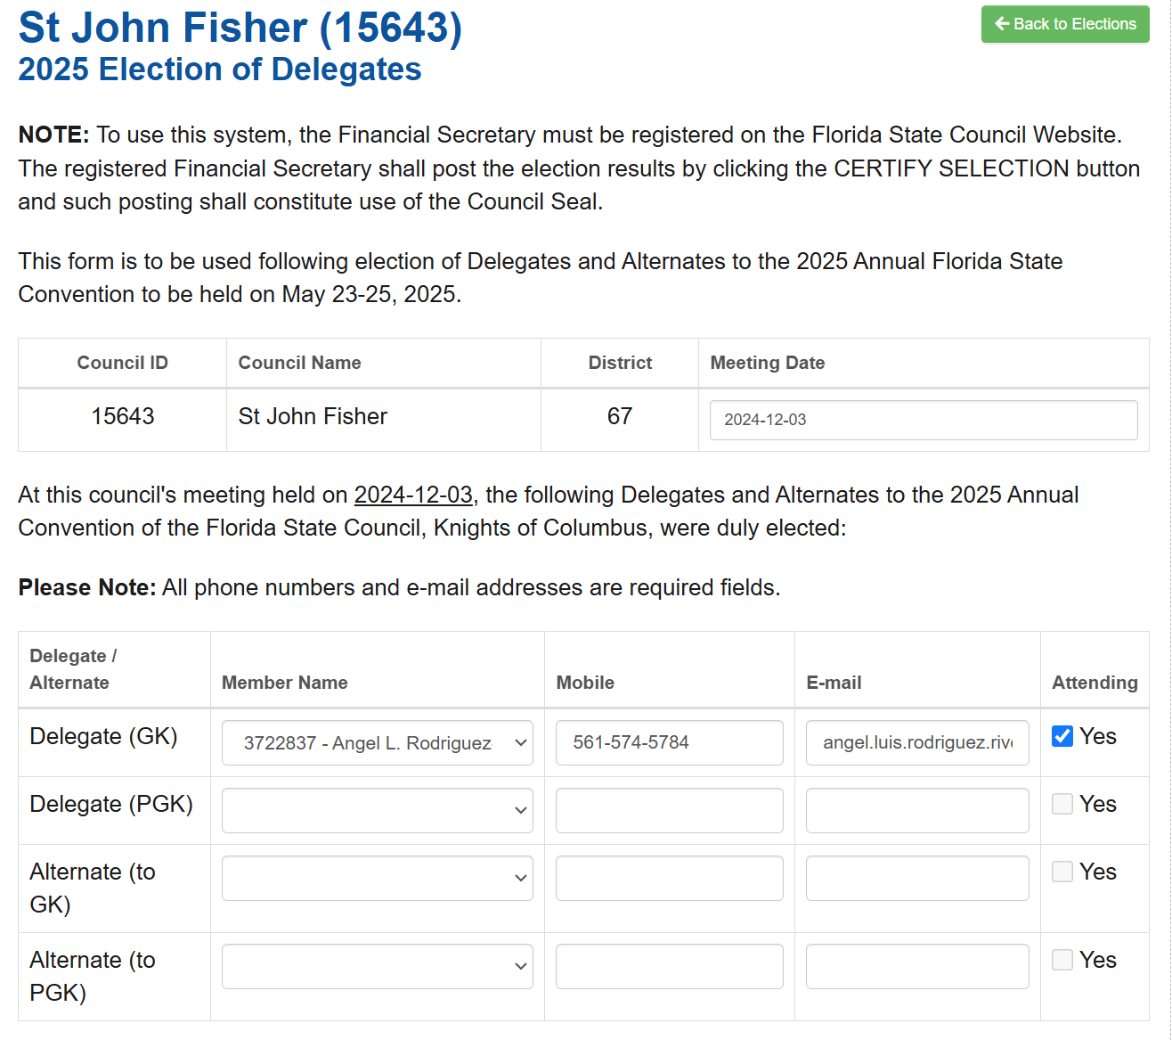
Election of Delegates form requires a date,
Two Delegate Names,
Two Alternate Names.
First delegate is the Grand Knight
Delegates and Alternates required to provide Mobile Phone Number and e-mail address.
Only two individuals from either delegates or alternates can have the “Yes” box checked.
If any nonattending delegate/alternante or ANY DUES PAID MEMBER wishes to attend the convention they will need e-mail the Convention Registration Chair!
Richard Gallant | District Deputy | Webmaster | Convention Registration | 4th Degree Exemplar
FloridaKnightsofColumbus@gmail.com | 561.707.5973

Slide 12
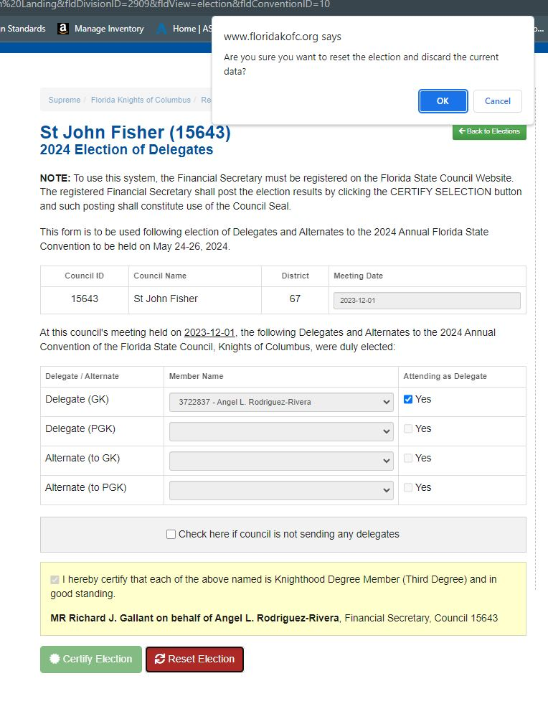
Up to April 1, 2026, the Grand Knight
Or Financial Secretary can reset the
Election.
To Reset Election, click the red Reset
Election box.
A warning will appear confirming the
Selection.
The Grand Knight will ALWAYS be the
First delegate, but that can be changed.
The Reset Election button is locked
After April 1, 2026.
Richard Gallant | District Deputy | Webmaster | Convention Registration | 4th Degree Exemplar
FloridaKnightsofColumbus@gmail.com | 561.707.5973

Slide 13
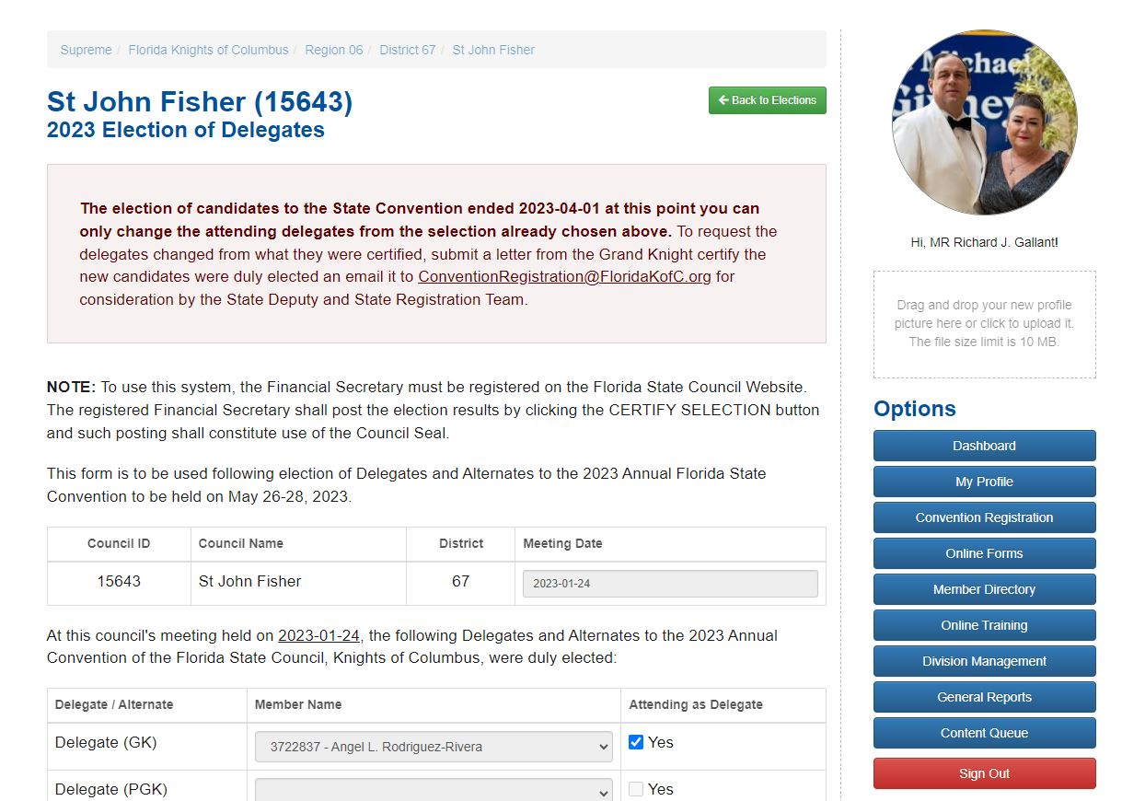
After April 1 2026, users will receive this notice.
After this date only the “Attending as Delegate”
“Yes” checkmarks can be changed.
Advise your councils to conduct elections early
After April 1, 2026 ANY COUNCIL who does not
wishes to complete their election of delegates
after April 1, 2026, the will be REQUIRED to email
The STATE DEPUTY and Convention Registration
Chairman to request an exemption!
Richard Gallant | District Deputy | Webmaster | Convention Registration | 4th Degree Exemplar
FloridaKnightsofColumbus@gmail.com | 561.707.5973

Slide 14
Delegates will receive the following e-mail.
Congratulations on being elected as a Delegate for the 2026 Florida State Convention. Your Financial Secretary has completed the task of certifying the election on behalf of your council. It is your responsibility to register for the 2026 Florida State Council Convention if you are attending. To do so log onto our website at https://www.floridakofc.org/ Click the "Member Log In" and log into your account. Next, from the Account Dashboard screen Click the blue box that says "Convention Registration" and follow the instructions.
Please remember that only two persons (Delegates or Alternates) from each Council may register as Delegates for the Convention. Those attending as Delegates must be already designated as attending the Convention by the Financial Secretary. However, you still must individually register for the Convention. Failure to register for the convention before May 1, 2026 will cause the registration team to deny you entry into the convention.
Be sure to review all of the pages pertaining to registration for the convention. This includes reviewing the dress code, spouse and guest activities, agenda on where to be and what to do and the most important, hotel registration.
Should you have any issues email ConventionRegistration@FloridaKofC.org
Richard Gallant | District Deputy | Webmaster | Convention Registration | 4th Degree Exemplar
FloridaKnightsofColumbus@gmail.com | 561.707.5973

Slide 15
Alternates will receive the following e-mail.
Congratulations on being elected as an Alternate Delegate for the 2026 Florida State Convention. Your Financial Secretary has completed the task of certifying the election on behalf of your council. As an alternate, you stand ready to become a delegate in the event the elected delegates are unable to attend. You will not be able to register for the 2026 Florida State Council Convention as a delegate until such time as one of the elected delegate cannot attend. If you move from alternate to delegate, it is your responsibility to register to attend. If you are chosen to be a delegate from your current alternate status you will need to log onto our website at https://www.floridakofc.org/ Click the "Member Log In" and log into your account. Next, from the Account Dashboard screen Click the blue box that says "Convention Registration" and follow the instructions.
If you are not chosen to be a delegate to the convention but still wish to attend at your own expense, email ConventionRegistration@FloridaKofC.org and in the email state you are an alternate delegate who wishes to attend the convention as a guest. A member of the registration team will email you back when you are able to complete your registration.
Please remember that only two persons (Delegates or Alternates) from each Council may register as Delegates for the Convention. Those attending as Delegates must be already designated as attending the Convention by the Financial Secretary. However, you still must individually register for the Convention. Failure to register for the convention before May 1, 2026 will cause the registration team to deny you entry into the convention.
Be sure to review all of the pages pertaining to registration for the convention. This includes reviewing the dress code, spouse and guest activities, agenda on where to be and what to do and the most important, hotel registration.
Should you have any issues email conventionregistration@FloridaKofC.org
Richard Gallant | District Deputy | Webmaster | Convention Registration | 4th Degree Exemplar
FloridaKnightsofColumbus@gmail.com | 561.707.5973

Slide 16
Questions regarding the Election of Delegates process!
Richard Gallant | District Deputy | Webmaster | Convention Registration | 4th Degree Exemplar
FloridaKnightsofColumbus@gmail.com | 561.707.5973

Slide 17
2026 Florida State Council
State Convention Registration
UPDATE
Richard Gallant | District Deputy | Webmaster | Convention Registration | 4th Degree Exemplar
FloridaKnightsofColumbus@gmail.com | 561.707.5973

Slide 18
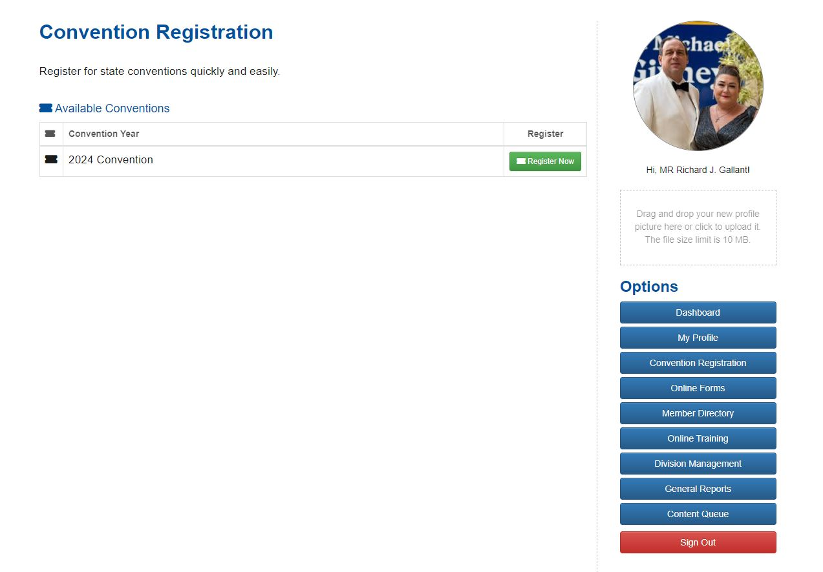
Updated Convention Registration Screen
Only the current years convention is listed
Past conventions are hidden from view.
Richard Gallant | District Deputy | Webmaster | Convention Registration | 4th Degree Exemplar
FloridaKnightsofColumbus@gmail.com | 561.707.5973

Slide 19
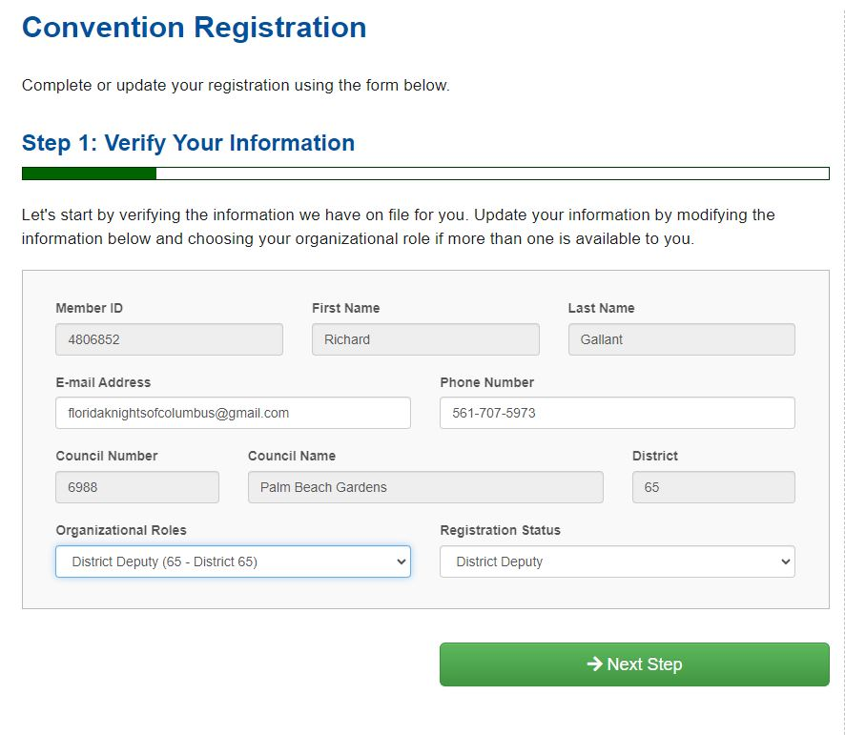
This is Step 1. Only the information in white can be edited from this screen.
Organizational Roles can be changed but delegates must select Delegate
Exceptions email me at ConventionRegistration@FloridaKofC.org
Richard Gallant | District Deputy | Webmaster | Convention Registration | 4th Degree Exemplar
FloridaKnightsofColumbus@gmail.com | 561.707.5973

Slide 20
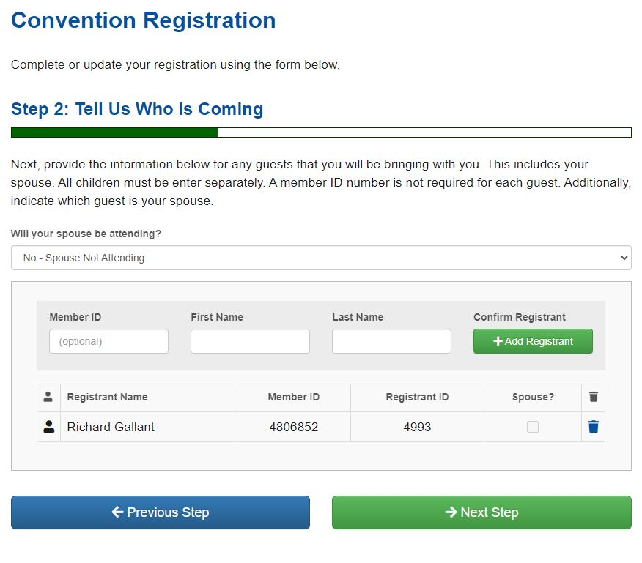
Step 2 – Adding your spouse
You must select if your spouse is attending.
You are required to add her name. If only bringing other non spouse
Add there names here.
Richard Gallant | District Deputy | Webmaster | Convention Registration | 4th Degree Exemplar
FloridaKnightsofColumbus@gmail.com | 561.707.5973

Slide 21
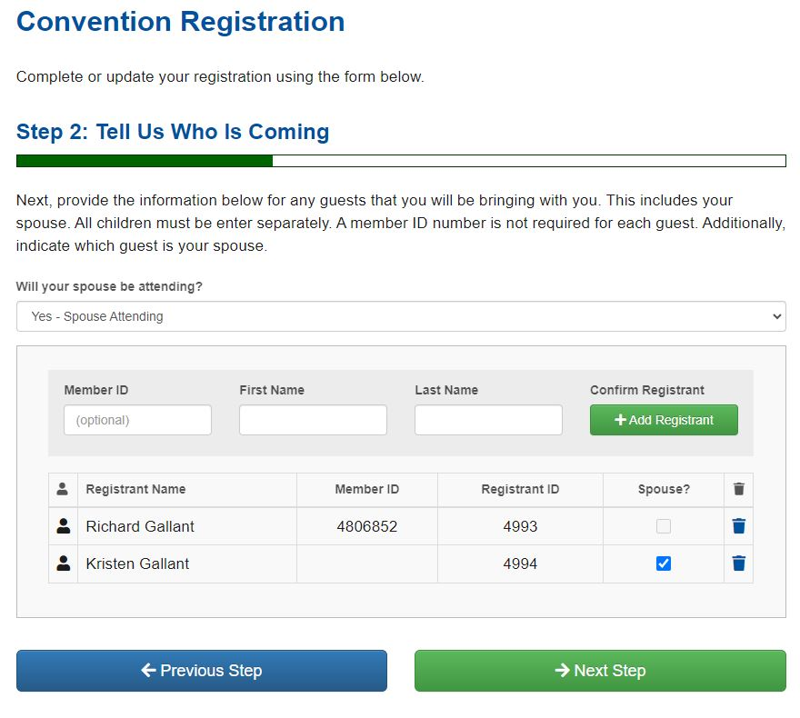
Step 2 After adding the wife and/or girlfriend
Richard Gallant | District Deputy | Webmaster | Convention Registration | 4th Degree Exemplar
FloridaKnightsofColumbus@gmail.com | 561.707.5973

Slide 22
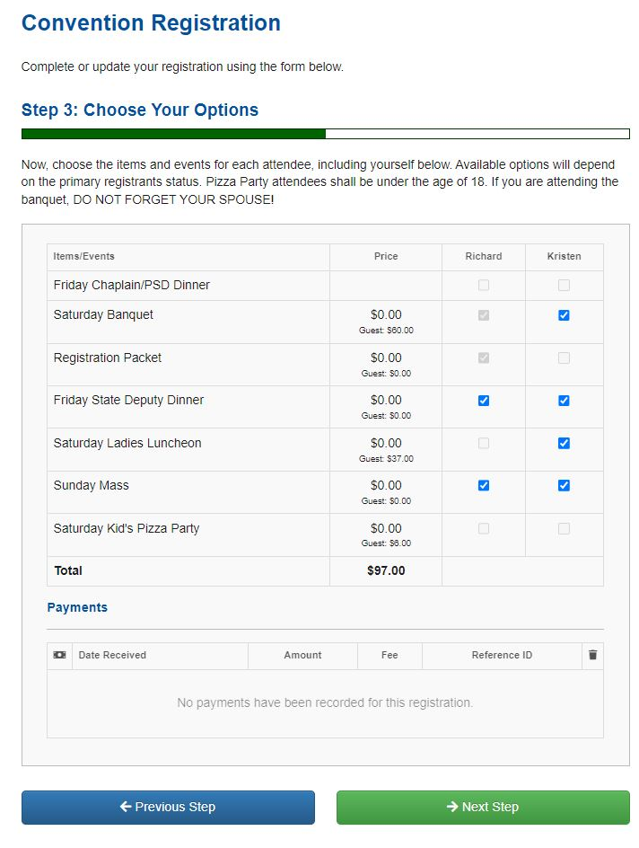
Step 3 – Choose Your Options
Greyed out boxes cannot be selected
Don’t forget your spouse (Ed)
New for this year…
You can only choose the
Saturday Banquet
Or the
Saturday Kid’s Pizza Party
Not Both (Yes, people did it last year!)
Total amount due will appear at the
Bottom.
Any previous payment made will appear
In the Payments box.
Richard Gallant | District Deputy | Webmaster | Convention Registration | 4th Degree Exemplar
FloridaKnightsofColumbus@gmail.com | 561.707.5973

Slide 23
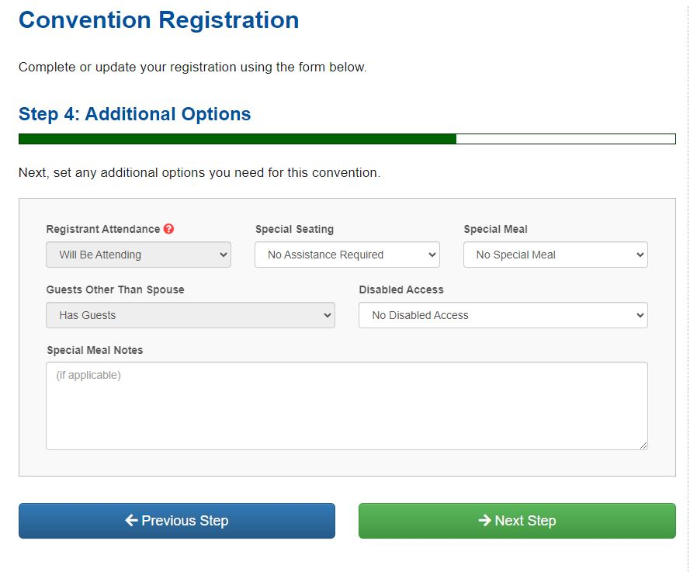
If someone wants to cancel after they register, change Registrant Attendance box from “Will be Attending” to “Will not be Attending”
This step is where other selections can be made.
If a delegate is not attending the banquet. Add a note in the Special Meal Notes
The Saturday Banquet is part of the convention and WILL BE DEDUCTED FROM THE DELEGATES PER DIEM WHETHER THEY ATTEND OR NOT. NO EXCEPTIONS!!!
Richard Gallant | District Deputy | Webmaster | Convention Registration | 4th Degree Exemplar
FloridaKnightsofColumbus@gmail.com | 561.707.5973

Slide 24
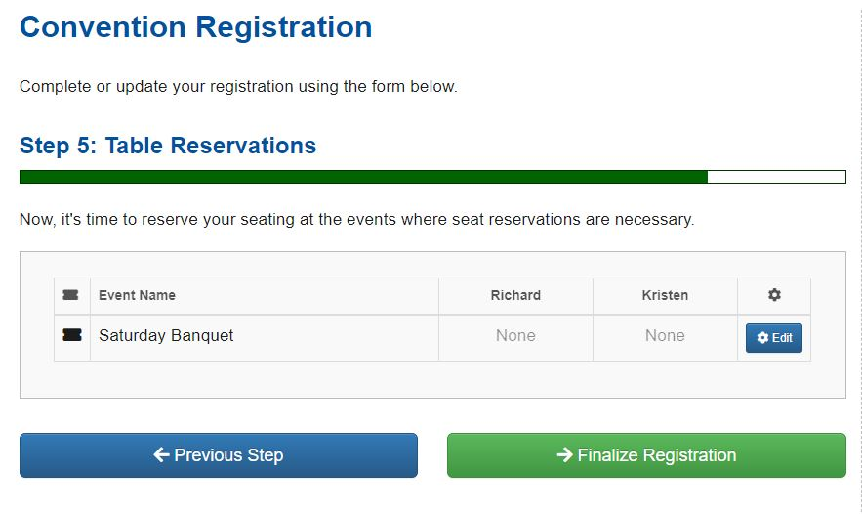
Step 5 – Table Reservations Change for this year..
You have to sit at the same table as your spouse. (Yes, that happened too)
The process has been updated so, in theory, if you register yourself and later
Your spouse, the system recognizes you are already at the table is only one seat
Remains. Click Edit to select the table you wish to sit at.
Richard Gallant | District Deputy | Webmaster | Convention Registration | 4th Degree Exemplar
FloridaKnightsofColumbus@gmail.com | 561.707.5973

Slide 25
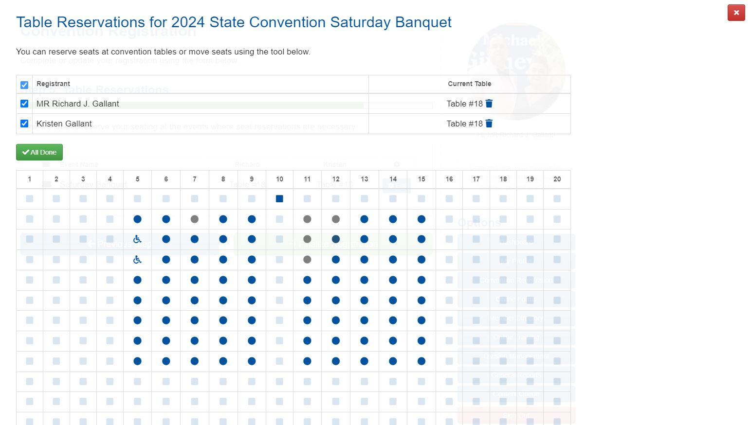
Select your table from this screen. You can only select the Round Blue Tables!
If “Special Seating” is selected from Step 4, the handicap tables can be selected.
The system is now set to require you and your spouse sit at the same table.
Richard Gallant | District Deputy | Webmaster | Convention Registration | 4th Degree Exemplar
FloridaKnightsofColumbus@gmail.com | 561.707.5973

Slide 26
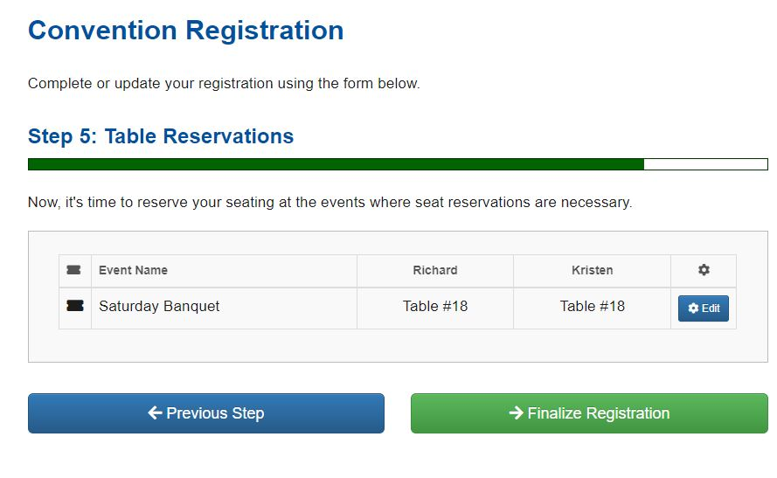
Step 5 – Table Reservations completion screen
Verify the table is selected.
Richard Gallant | District Deputy | Webmaster | Convention Registration | 4th Degree Exemplar
FloridaKnightsofColumbus@gmail.com | 561.707.5973

Slide 27
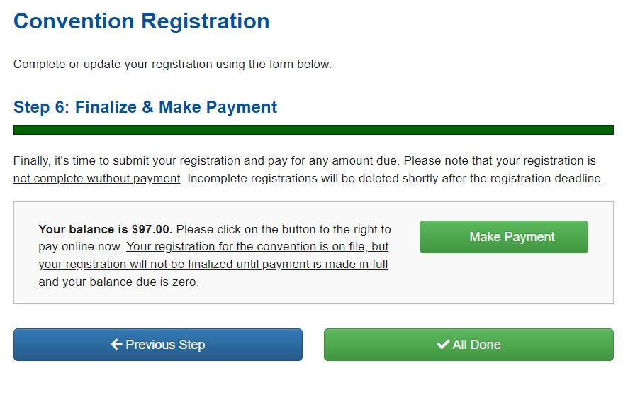
Step 6 – Finalize & Make Payment
Click the box that says Make Payment. The FSC uses PayPal.
Payment button takes you to PayPal's website.
If you wish not to use PayPal email StateConvention@FloridaKofC.org
The State Deputy is the ONLY PERSON who can grant ANY exceptions to pay outside
Of PayPal.
Richard Gallant | District Deputy | Webmaster | Convention Registration | 4th Degree Exemplar
FloridaKnightsofColumbus@gmail.com | 561.707.5973

Slide 28
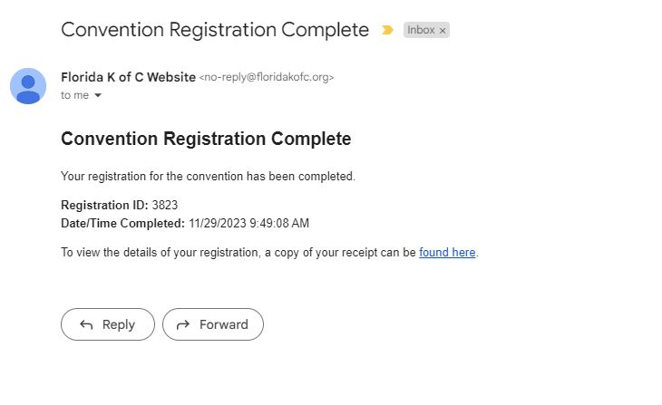
The registrant will receive an email confirming their registration.
Richard Gallant | District Deputy | Webmaster | Convention Registration | 4th Degree Exemplar
FloridaKnightsofColumbus@gmail.com | 561.707.5973

Slide 29
Questions about the
Convention Registration Process
Richard Gallant | District Deputy | Webmaster | Convention Registration | 4th Degree Exemplar
FloridaKnightsofColumbus@gmail.com | 561.707.5973

Slide 30
The Florida State Council is required to submit, annually, the
Annual Survey of Fraternal Activity
to Supreme on or before January 31, 2026.
The following positions are REQUIRED to provide an accounting of hours served for SUPREME, STATE, DISTRICT activities. THIS DOES NOT INCLUDE INDIVIDUAL COUNCIL ACTIVITIES! This form is ONLY for YOUR hours worked on behalf of Supreme, State, and District activities.
Richard Gallant | District Deputy | Webmaster | Convention Registration | 4th Degree Exemplar
FloridaKnightsofColumbus@gmail.com | 561.707.5973

Slide 31
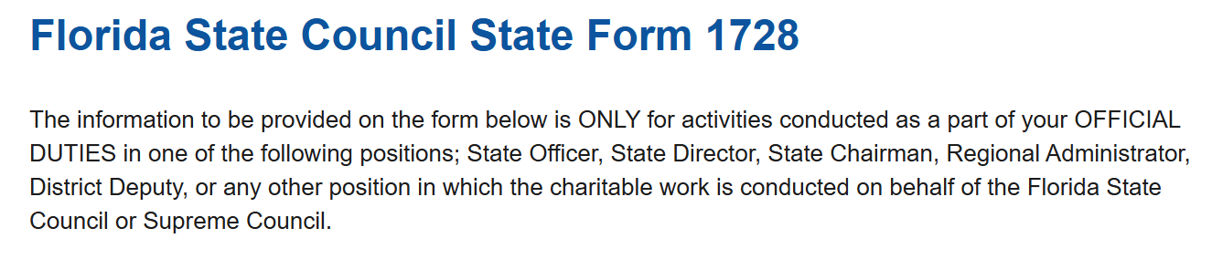
DO NOT USE THE FORM FOR YOUR DIRECT COUNCIL OR ASSEMBLY OR FOR SUBMITTING ACTIVITIES FOR A COUNCIL OR ASSEMBLY!!!
Richard Gallant | District Deputy | Webmaster | Convention Registration | 4th Degree Exemplar
FloridaKnightsofColumbus@gmail.com | 561.707.5973

Slide 32
¡NO USE ESTE FORMULARIO PARA SU CONSEJO O ASAMBLEA DIRECTA NI PARA ENVIAR ACTIVIDADES PARA UN CONSEJO O ASAMBLEA!
Richard Gallant | District Deputy | Webmaster | Convention Registration | 4th Degree Exemplar
FloridaKnightsofColumbus@gmail.com | 561.707.5973

Slide 33
PA ITILIZE FÒM LA POU KONSÈY OU Asanble DIRET OU OU POU SOUMISYE AKTIVITE POU YON KONSÈY OSWA Asanble!!!
Richard Gallant | District Deputy | Webmaster | Convention Registration | 4th Degree Exemplar
FloridaKnightsofColumbus@gmail.com | 561.707.5973

Slide 34
KHÔNG SỬ DỤNG BIỂU MẪU CHO HỘI ĐỒNG HOẶC ĐẠI HỘI TRỰC TIẾP CỦA BẠN HOẶC ĐỂ NỘP CÁC HOẠT ĐỘNG CHO HỘI ĐỒNG HOẶC ĐẠI HỘI!!!
Richard Gallant | District Deputy | Webmaster | Convention Registration | 4th Degree Exemplar
FloridaKnightsofColumbus@gmail.com | 561.707.5973

Slide 35
請勿將該表格用於您的直接理事會或大會，或用於向理事會或大會提交活動！
Qǐng wù jiāng gāi biǎogé yòng yú nín de zhíjiē lǐshì huì huò dàhuì, huò yòng yú xiàng lǐshì huì huò dàhuì tíjiāo huódòng!
Richard Gallant | District Deputy | Webmaster | Convention Registration | 4th Degree Exemplar
FloridaKnightsofColumbus@gmail.com | 561.707.5973

Slide 36
このフォームを、直接の評議会や集会、あるいは評議会や集会の活動の提出に使用しないでください。
Kono fōmu o, chokusetsu no hyōgi-kai ya shūkai, aruiwa hyōgi-kai ya shūkai no katsudō no teishutsu ni shiyō shinaide kudasai.
Richard Gallant | District Deputy | Webmaster | Convention Registration | 4th Degree Exemplar
FloridaKnightsofColumbus@gmail.com | 561.707.5973

Slide 37
NIE UŻYWAJ TEGO FORMULARZA W ODNIESIENIU DO RADY LUB ZGROMADZENIA ANI DO ZGŁASZANIA DZIAŁAŃ RADY LUB ZGROMADZENIA!!!
Richard Gallant | District Deputy | Webmaster | Convention Registration | 4th Degree Exemplar
FloridaKnightsofColumbus@gmail.com | 561.707.5973

Slide 38
Faith Activities
a. Refund Support Vocations Program - direct contributions to students studying to become priests or postulants.
b. Church Facilities - construction, repairs, remodeling, memorial gifts, etc.
c. Catholic Schools/Seminaries - donations, grants, equipment, etc.
d. Religious/Vocations Education - scholarships, CCD, lay apostolate, programs, speakers, films, program materials, etc.
e. Prayer & Study Programs - direct contributions to prayer groups, faith program materials, domestic church kiosk, rosary program, Marian Icon program, etc.
f. Sacramental Gifts - costs related to gifts presented to congregation.
g. Miscellaneous Faith Activities - all other disbursements not outlined above relating to Faith Activities.
Richard Gallant | District Deputy | Webmaster | Convention Registration | 4th Degree Exemplar
FloridaKnightsofColumbus@gmail.com | 561.707.5973

Slide 39
Family Activities
a. Food for Families - direct contributions to food banks, pantries, soup kitchens.
b. Family Formation Programs - Family Fully Alive, Family of the Month/Year, Consecration to the Holy Family, Good Friday Family Promotion, etc.
c. Keep Christ in Christmas - all contributions to KCIC, Journey to the Inn, Light Up for Christ, Christmas Poster Contest, billboard signs, etc.
d. Family Week - direct contributions to the coordination, promotion, and conduct of this program.
e. Family Prayer Night - direct contributions to coordination and execution of this program.
f. Miscellaneous Family Programs - all other disbursements not outlined above relating to Family Activities.
Richard Gallant | District Deputy | Webmaster | Convention Registration | 4th Degree Exemplar
FloridaKnightsofColumbus@gmail.com | 561.707.5973

Slide 40
Community Activities
a. Coats For Kids - direct contributions to purchasing and distribution of coats to those in need.
b. Global Wheelchair Mission - direct contributions to purchasing and coordination of wheelchair distribution to the needy.
c. Habitat for Humanity - direct contributions to Habitat for Humanity projects, materials, tools, and construction.
d. Disaster Preparedness/Relief - direct contributions to planning and executing disaster preparedness and response, food, water, equipment, etc.
e. Physically Disabled/Intellectual Disabilities - direct contributions to schools, care services, organizations, etc.
f. Elderly/Widow(er) Care - direct contributions to homes for the aged, retired/senior volunteer programs, construction, repairs, remodeling, gifts, etc.
g. Hospitals/Health Organizations - direct contributions to Red Cross, Hospice, heart/cancer funds, equipment, construction, donations, etc.
h. Columbian Squires - direct contributions to the operations and support of the Columbian Squires program.
i. Scouting/Youth Groups - direct contributions to sponsorship, volunteer efforts, projects, 4-H, Big Brothers, CYO, mentoring, etc.
j. Athletics - direct contributions to council sport events, youth sport sponsorships, equipment, transportation, etc.
k. Youth Welfare/Service - direct contributions to substance/child abuse, foster parents, etc.
l. Scholarships/Education - direct contributions to career nights, essay contests, scholarships, tuition, fund raising, etc.
m. Veteran Military/VAVS - direct contributions to veterans, VA hospital support/visitation, memorials, parades, etc.
n. Miscellaneous Community/Youth Activities - all other disbursements not outlined above relating to Community Activities.

Slide 41
Life Activities
a. Special Olympics - direct contributions to local, state, and national events.
b. Marches for Life - direct contributions to local, state, and nation marches.
c. Ultrasound Initiative - direct contributions to the purchase and placement of Ultrasound machines for crisis pregnancy centers.
d. Pregnancy Center Support - direct contributions to donations, diapers, supplies, baby showers, birthright, etc.
e. Christian Refugee Relief - direct contributions to aid provided to refugee relief, Solidarity Crosses.
f. Memorials to Unborn Children - direct contributions to purchases, fund raisers, donations, construction, etc.
g. Miscellaneous Life Activities - all other disbursements not outlined above relating to Life Activities.
Meetings
1. Business - discussing or conducting business.
2. Social - dinners, dances, parties, etc.
3. Special/Committee - lectures, films, educational, etc.
Richard Gallant | District Deputy | Webmaster | Convention Registration | 4th Degree Exemplar
FloridaKnightsofColumbus@gmail.com | 561.707.5973

Slide 42
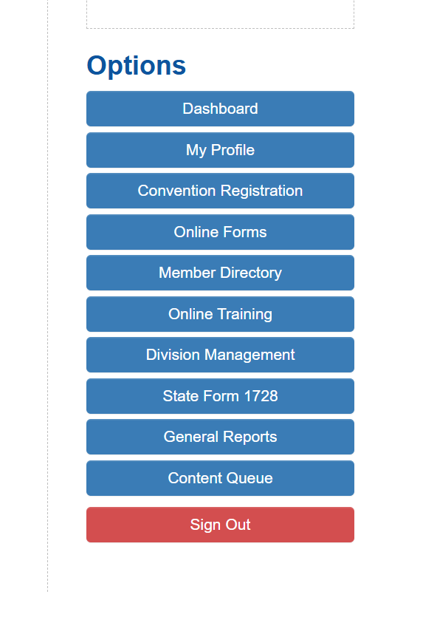
To complete the State Form 1728 click the link in the options bar in the Account Dashboard.
ONLY users who are REQUIRED to complete this form have access to this form.
Richard Gallant | District Deputy | Webmaster | Convention Registration | 4th Degree Exemplar
FloridaKnightsofColumbus@gmail.com | 561.707.5973

Slide 43
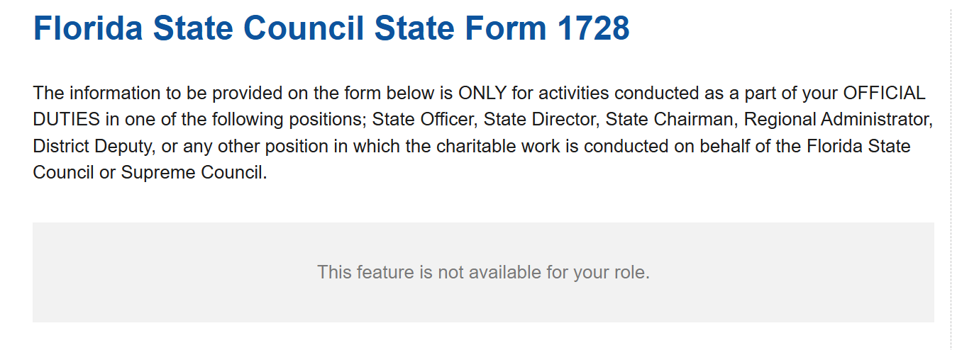
All users can access the link but only those authorized can actually access the form. If a member calls and advises they cant access the form… They are not in the required reporting positions for THIS FORM. They must use the Supreme form found here.
https://www.kofc.org/en/forms/spa/invite.html?lang=en&form=1728C.02
Richard Gallant | District Deputy | Webmaster | Convention Registration | 4th Degree Exemplar
FloridaKnightsofColumbus@gmail.com | 561.707.5973

Slide 44
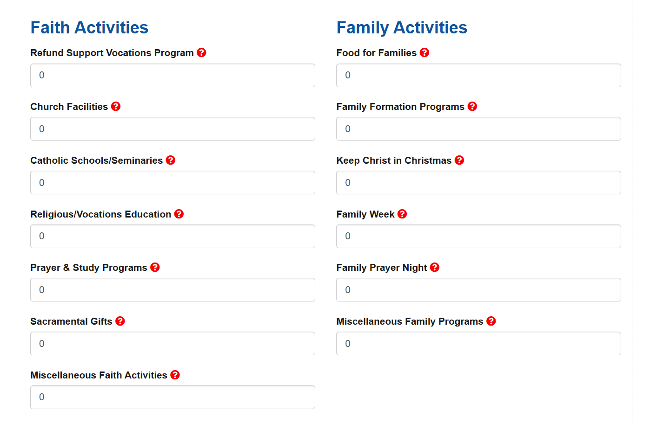
Richard Gallant | District Deputy | Webmaster | Convention Registration | 4th Degree Exemplar
FloridaKnightsofColumbus@gmail.com | 561.707.5973

Slide 45
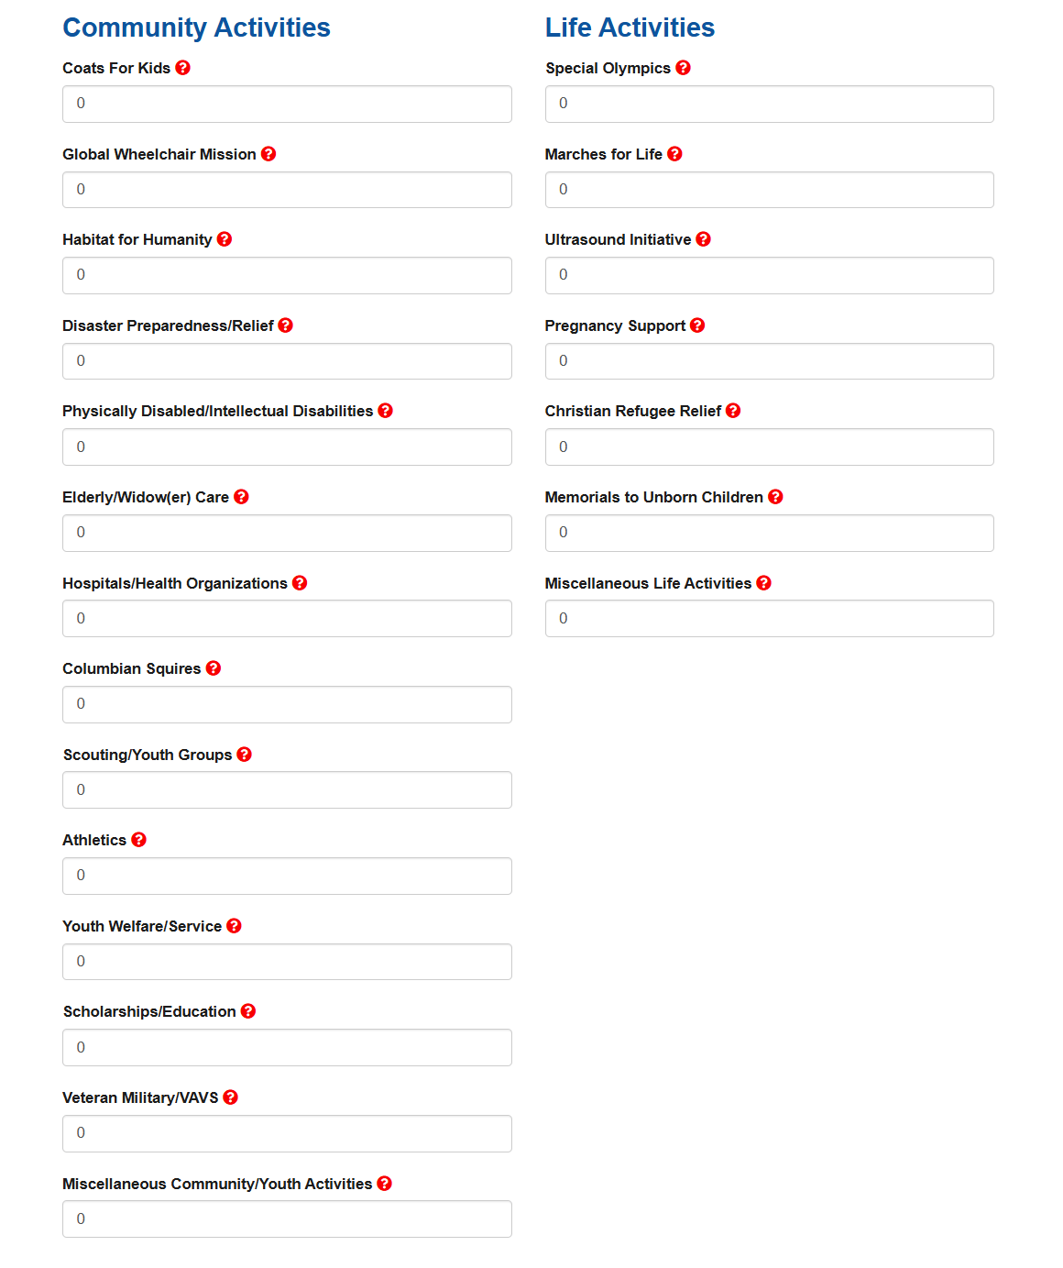
Richard Gallant | District Deputy | Webmaster | Convention Registration | 4th Degree Exemplar
FloridaKnightsofColumbus@gmail.com | 561.707.5973

Slide 46
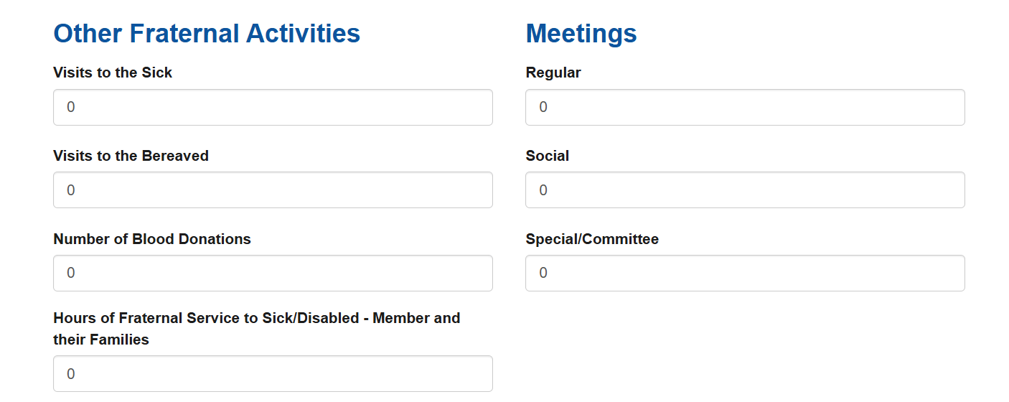
Richard Gallant | District Deputy | Webmaster | Convention Registration | 4th Degree Exemplar
FloridaKnightsofColumbus@gmail.com | 561.707.5973

Slide 47

Richard Gallant | District Deputy | Webmaster | Convention Registration | 4th Degree Exemplar
FloridaKnightsofColumbus@gmail.com | 561.707.5973

Slide 48
Remember the State Form 1728 is to only be used by State Officers, State Directors, State Chairmans, Regional Administrators, District Deputies, or any other position in which the charitable work is conducted on behalf of the Florida State Council or Supreme Council.
Richard Gallant | District Deputy | Webmaster | Convention Registration | 4th Degree Exemplar
FloridaKnightsofColumbus@gmail.com | 561.707.5973

Slide 49
Questions regarding the STATE Form 1728
Richard Gallant | District Deputy | Webmaster | Convention Registration | 4th Degree Exemplar
FloridaKnightsofColumbus@gmail.com | 561.707.5973

Slide 50
Richard Gallant | District Deputy | Webmaster | Convention Registration | 4th Degree Exemplar
FloridaKnightsofColumbus@gmail.com | 561.707.5973

Slide 51
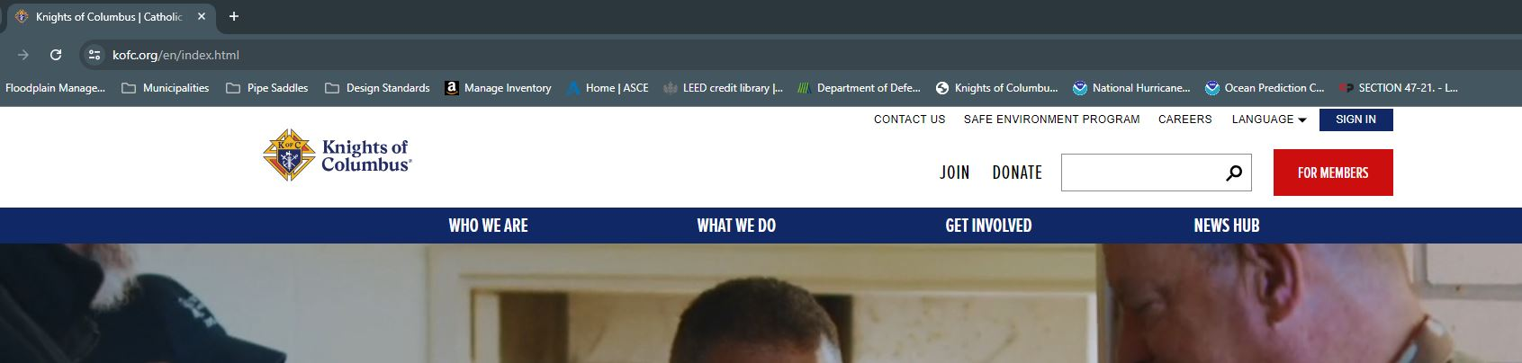
Accessing Member Resources WITHOUT a Log in to Officers Online First go to https://KofC.org
Richard Gallant | District Deputy | Webmaster | Convention Registration | 4th Degree Exemplar
FloridaKnightsofColumbus@gmail.com | 561.707.5973

Slide 52
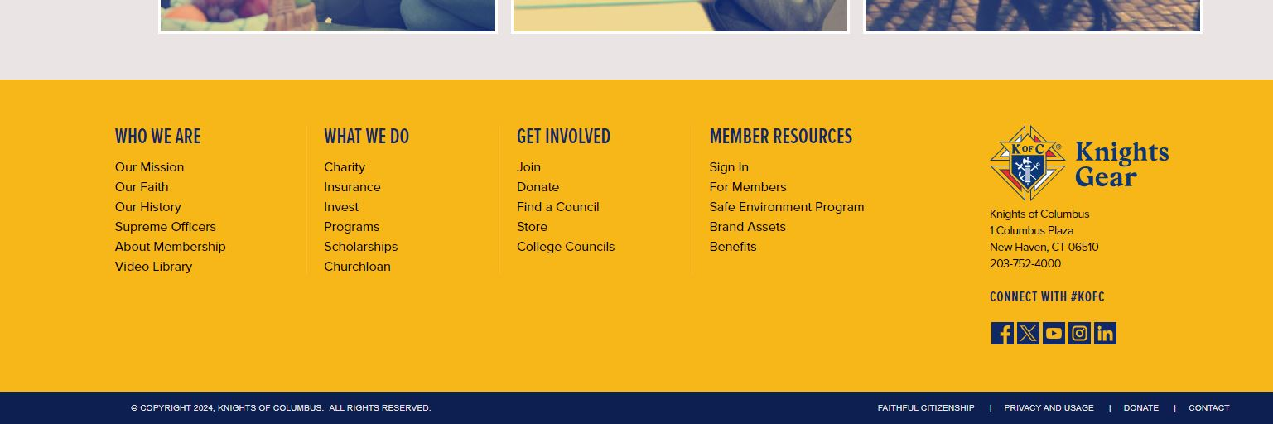
Scroll ALL the way to the Bottom of the Home Page
One Can Sign in Here
Click For Members
Richard Gallant | District Deputy | Webmaster | Convention Registration | 4th Degree Exemplar
FloridaKnightsofColumbus@gmail.com | 561.707.5973

Slide 53
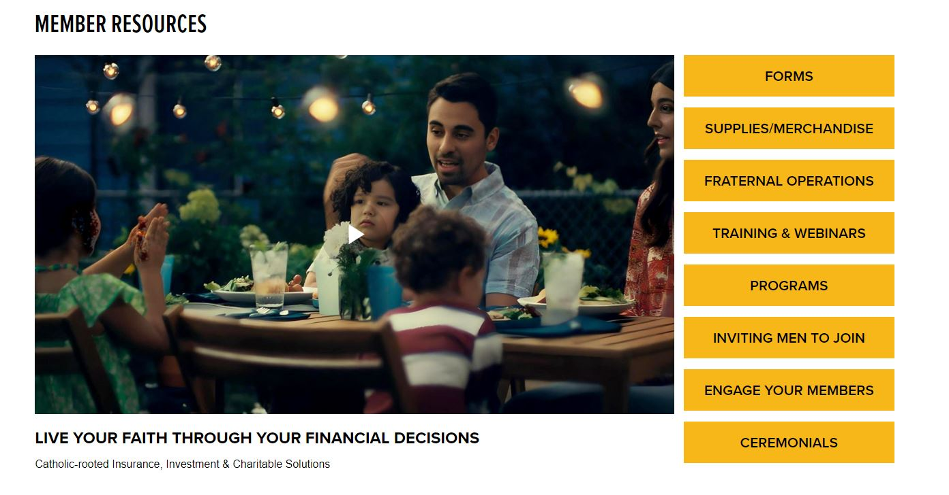
Richard Gallant | District Deputy | Webmaster | Convention Registration | 4th Degree Exemplar
FloridaKnightsofColumbus@gmail.com | 561.707.5973

Slide 54
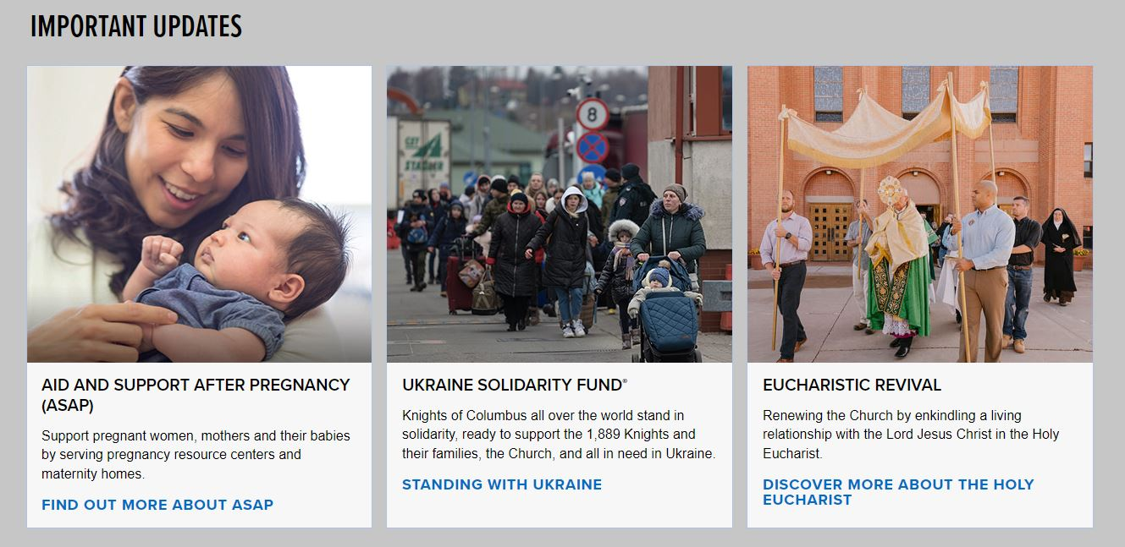
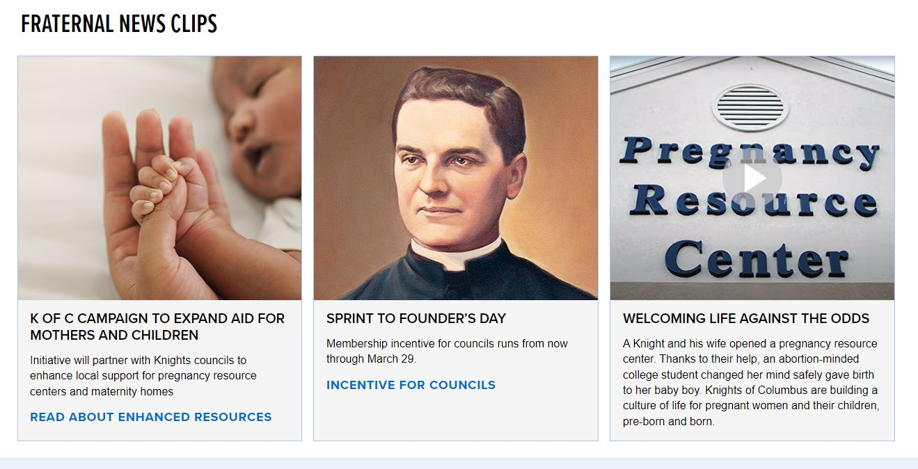
Other Items Found in Member Resources
Richard Gallant | District Deputy | Webmaster | Convention Registration | 4th Degree Exemplar
FloridaKnightsofColumbus@gmail.com | 561.707.5973

Slide 55
Richard Gallant | District Deputy | Webmaster | Convention Registration | 4th Degree Exemplar
FloridaKnightsofColumbus@gmail.com | 561.707.5973

Slide 56
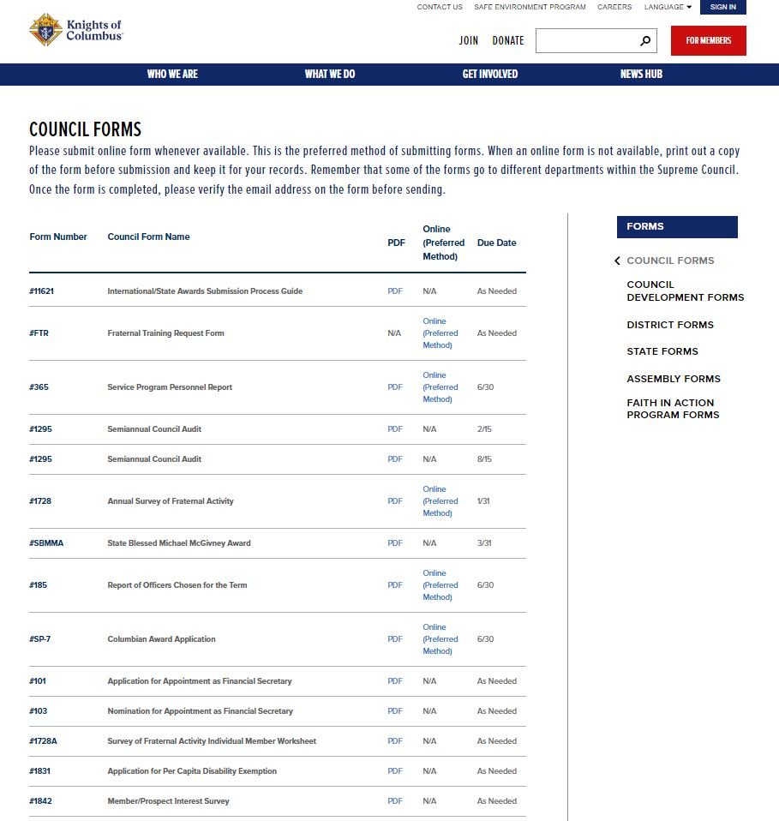
Council Forms Page Contains ALL of the Important Forms for a Council Officer
This page also includes Access to Council Development, District, State, Assembly, and
Faith in Action Forms
Richard Gallant | District Deputy | Webmaster | Convention Registration | 4th Degree Exemplar
FloridaKnightsofColumbus@gmail.com | 561.707.5973

Slide 57
Richard Gallant | District Deputy | Webmaster | Convention Registration | 4th Degree Exemplar
FloridaKnightsofColumbus@gmail.com | 561.707.5973

Slide 58
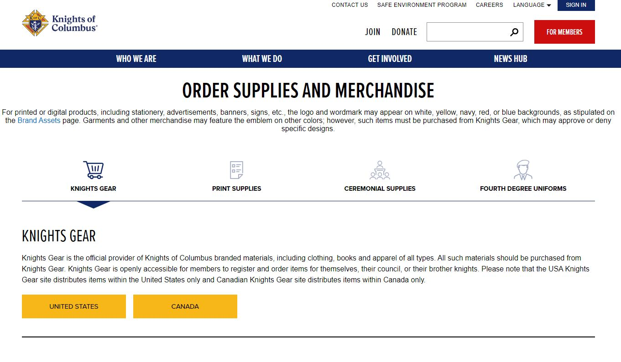
Supplies and Merchandise can be accessed from the Supplies/Merchandise Tab
Richard Gallant | District Deputy | Webmaster | Convention Registration | 4th Degree Exemplar
FloridaKnightsofColumbus@gmail.com | 561.707.5973

Slide 59
Richard Gallant | District Deputy | Webmaster | Convention Registration | 4th Degree Exemplar
FloridaKnightsofColumbus@gmail.com | 561.707.5973

Slide 60
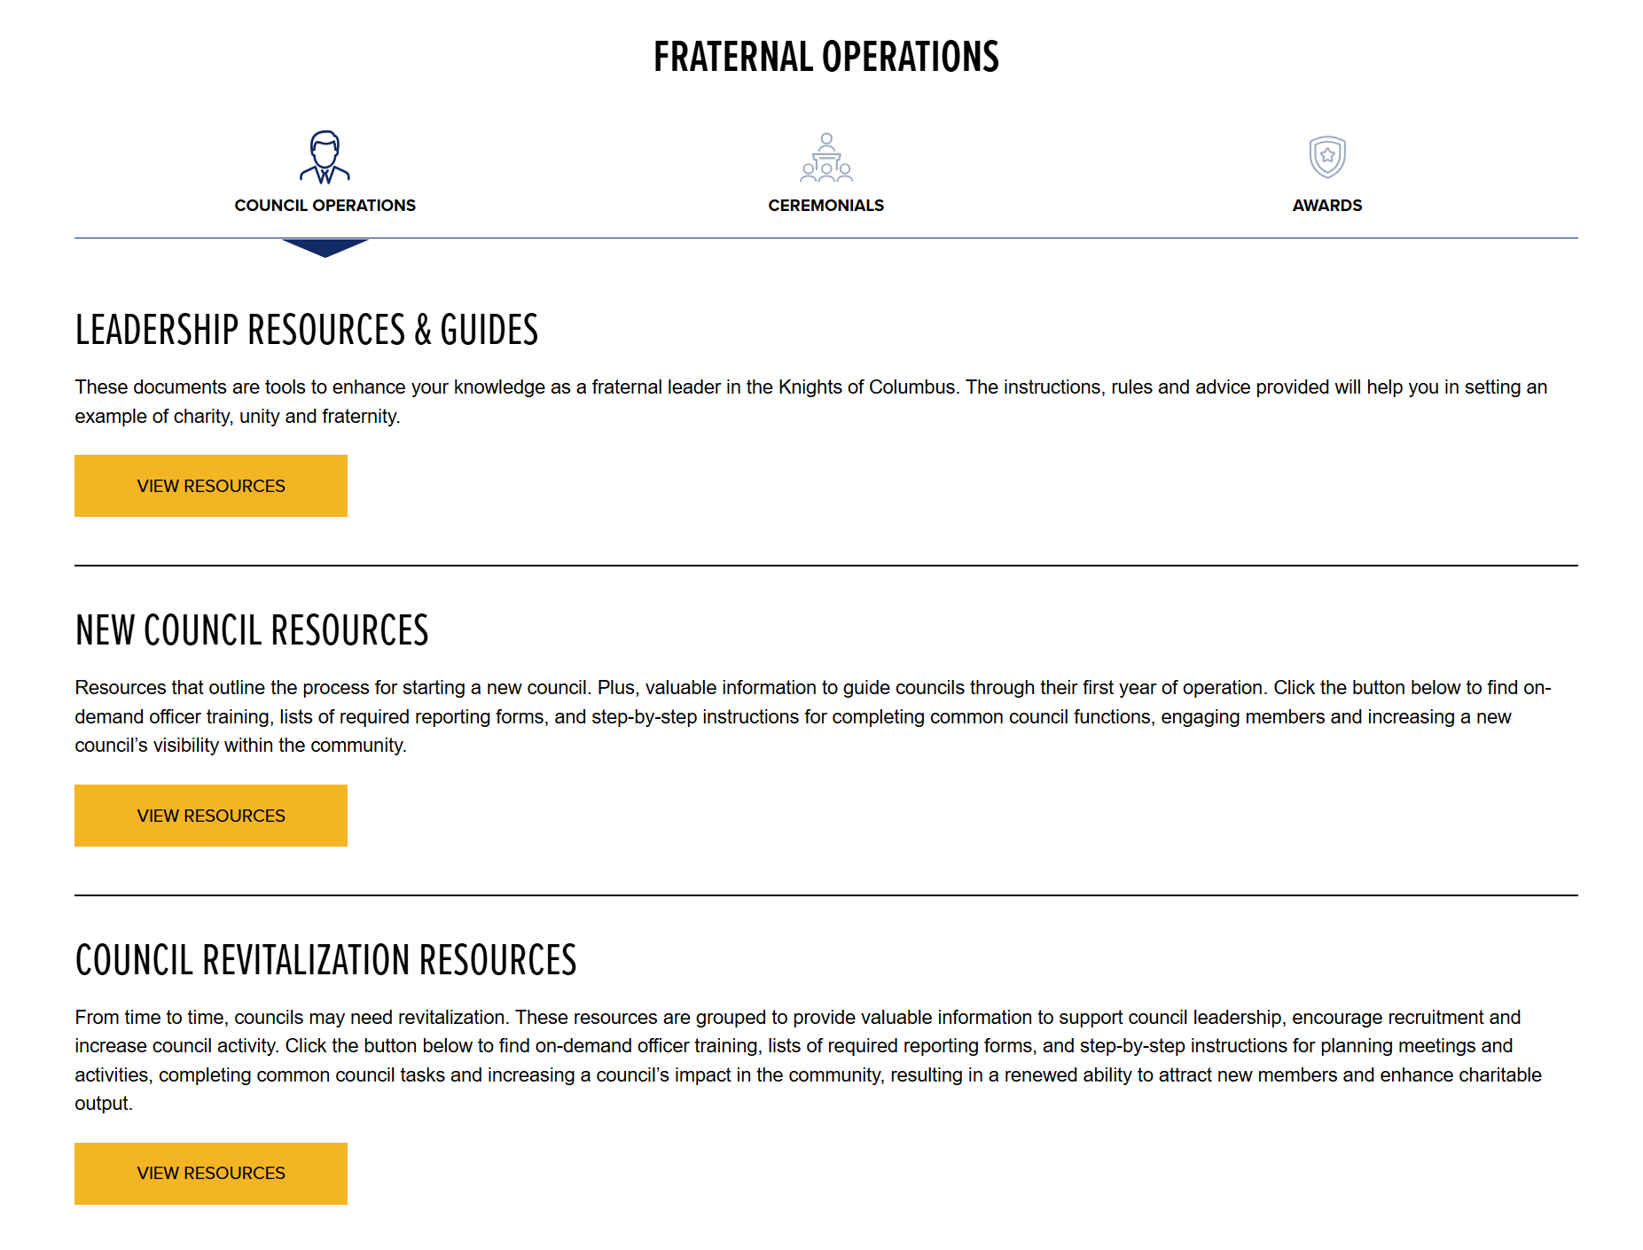
Under the Fraternal Operations Tab
Leadership Resources, New Council,
and Council Revitalization Resources
can be found
Richard Gallant | District Deputy | Webmaster | Convention Registration | 4th Degree Exemplar
FloridaKnightsofColumbus@gmail.com | 561.707.5973

Slide 61
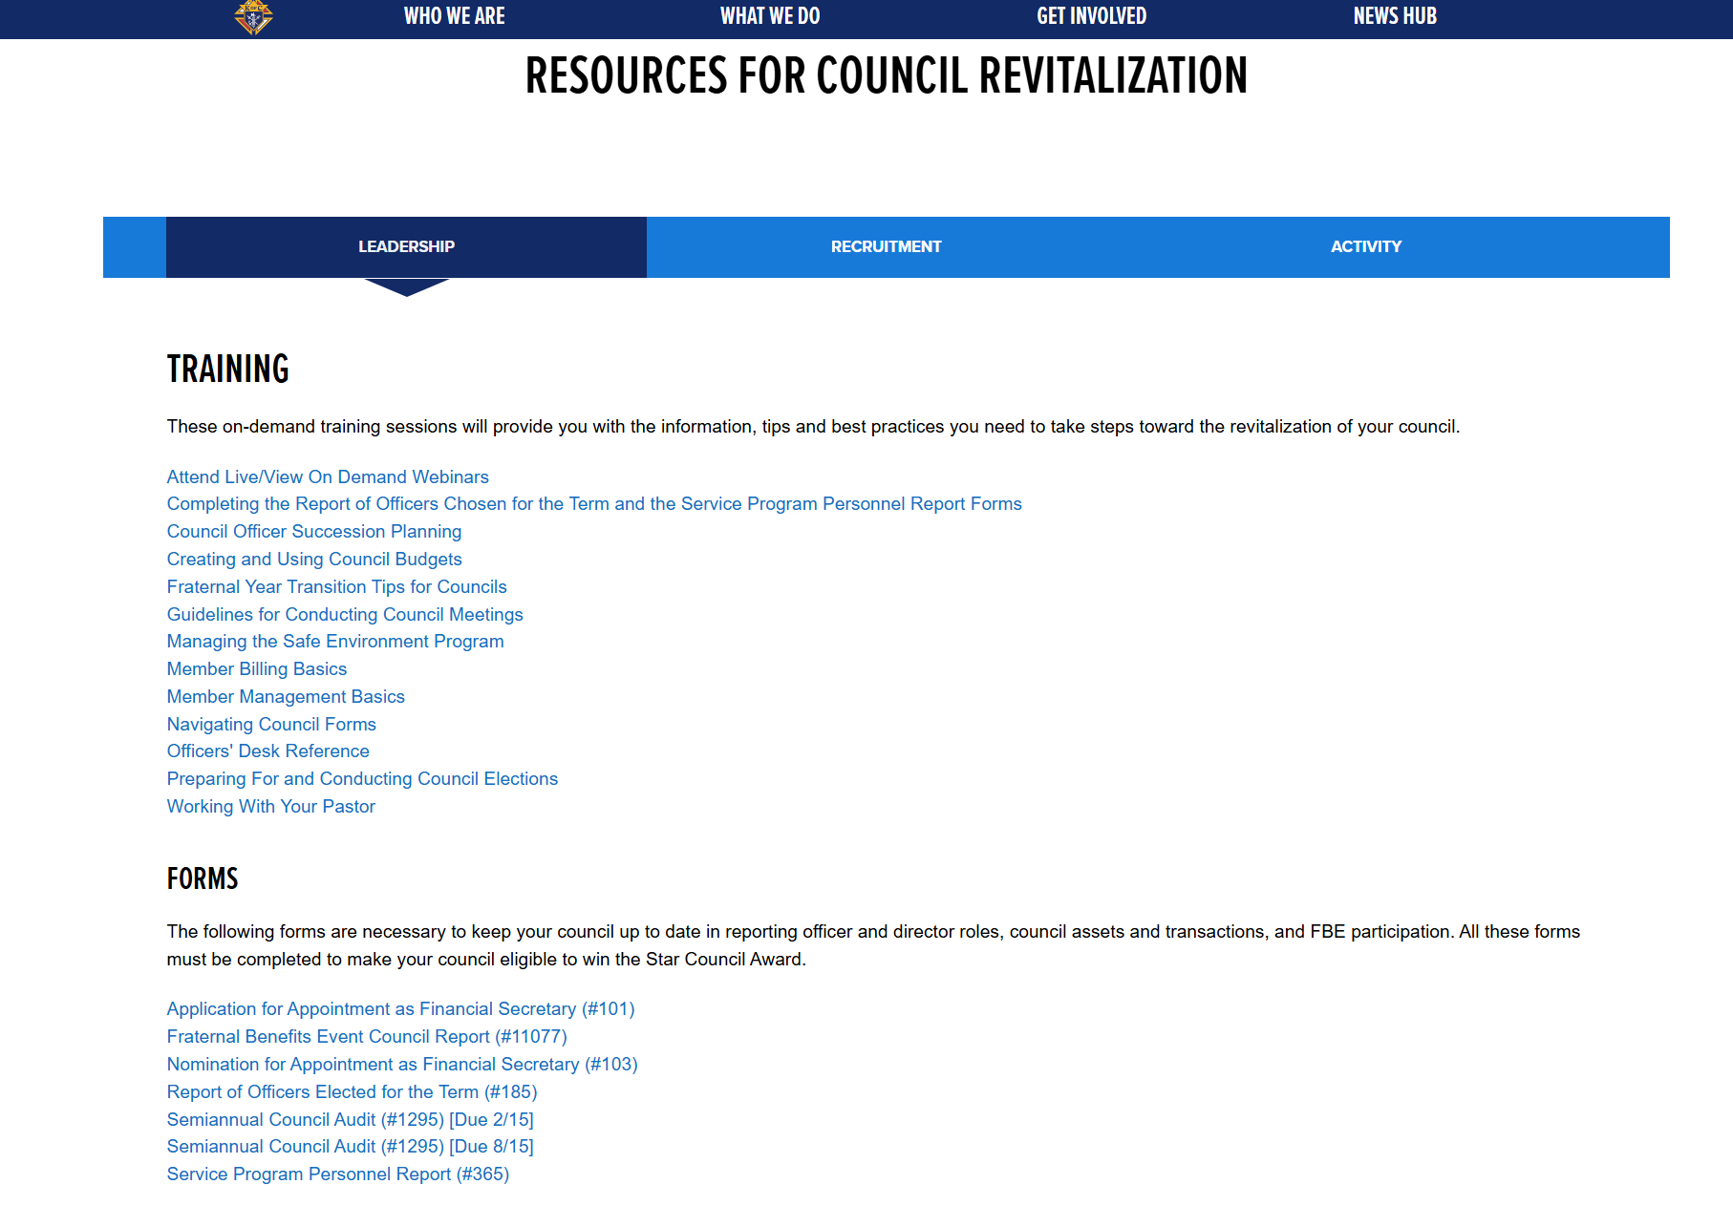
Council Revitalization tab is a clearing
house of almost every training your
Councils will need to succeed.
As a District Deputy YOU need to
review EVERY video and form.
Richard Gallant | District Deputy | Webmaster | Convention Registration | 4th Degree Exemplar
FloridaKnightsofColumbus@gmail.com | 561.707.5973

Slide 62
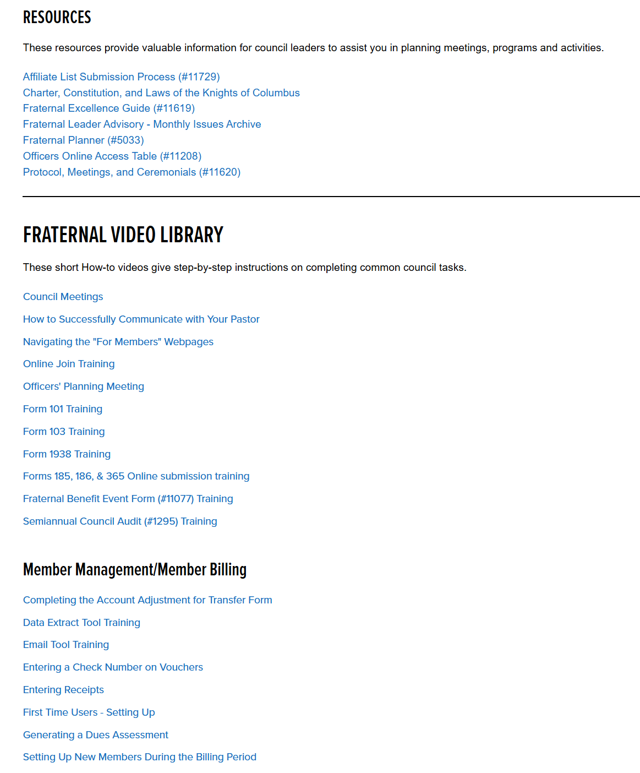
The Council Revitalization tab also contains
Resources, and the Fraternal Video Library including Member Management/Member Billing instructions.
REVIEW ALL OF THIS!!!
Richard Gallant | District Deputy | Webmaster | Convention Registration | 4th Degree Exemplar
FloridaKnightsofColumbus@gmail.com | 561.707.5973

Slide 63
Richard Gallant | District Deputy | Webmaster | Convention Registration | 4th Degree Exemplar
FloridaKnightsofColumbus@gmail.com | 561.707.5973

Slide 64
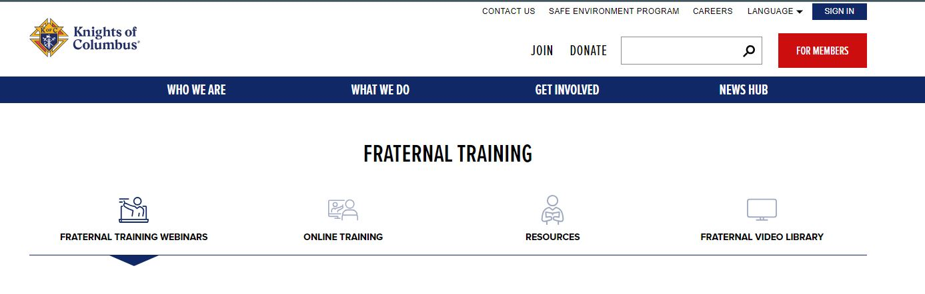
The Training & Webinar Tab Allows Access to a Plethora of Training Resources
Richard Gallant | District Deputy | Webmaster | Convention Registration | 4th Degree Exemplar
FloridaKnightsofColumbus@gmail.com | 561.707.5973

Slide 65
Richard Gallant | District Deputy | Webmaster | Convention Registration | 4th Degree Exemplar
FloridaKnightsofColumbus@gmail.com | 561.707.5973

Slide 66
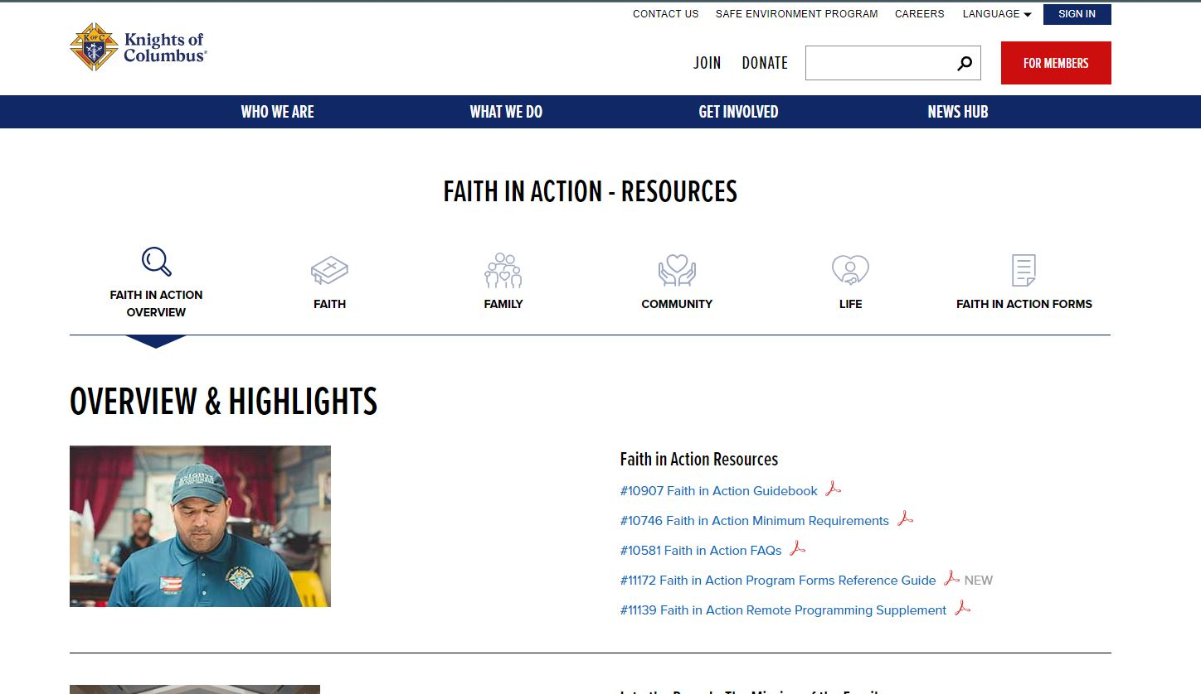
The Program Tab Opens the Window to Access the Faith in Action Program.
Richard Gallant | District Deputy | Webmaster | Convention Registration | 4th Degree Exemplar
FloridaKnightsofColumbus@gmail.com | 561.707.5973

Slide 67
Richard Gallant | District Deputy | Webmaster | Convention Registration | 4th Degree Exemplar
FloridaKnightsofColumbus@gmail.com | 561.707.5973

Slide 68
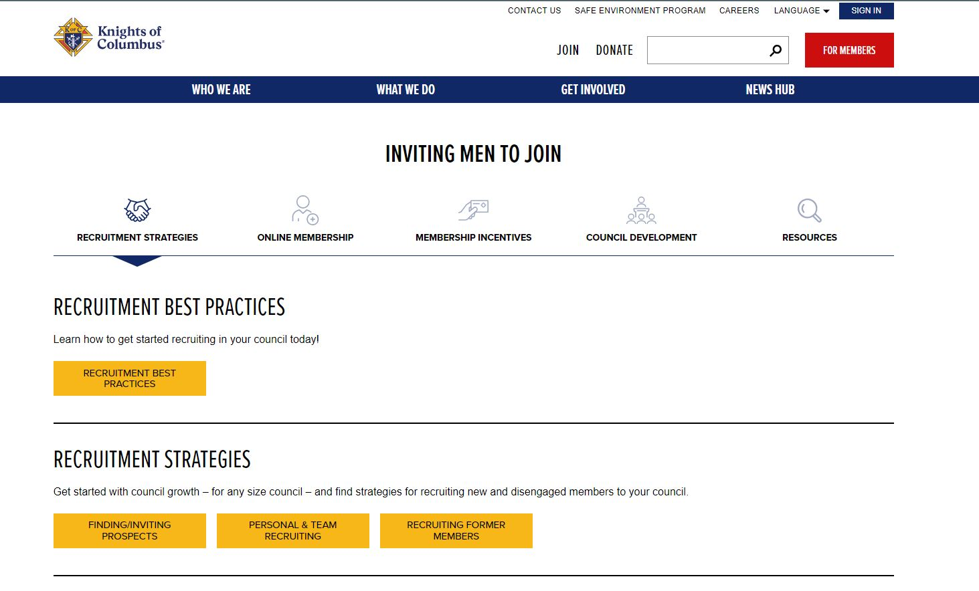
The Inviting Men to Join Tab Permits the Viewer to View Training, Guides, Resources, Strategies, and Everything for Membership
Richard Gallant | District Deputy | Webmaster | Convention Registration | 4th Degree Exemplar
FloridaKnightsofColumbus@gmail.com | 561.707.5973

Slide 69
Richard Gallant | District Deputy | Webmaster | Convention Registration | 4th Degree Exemplar
FloridaKnightsofColumbus@gmail.com | 561.707.5973

Slide 70
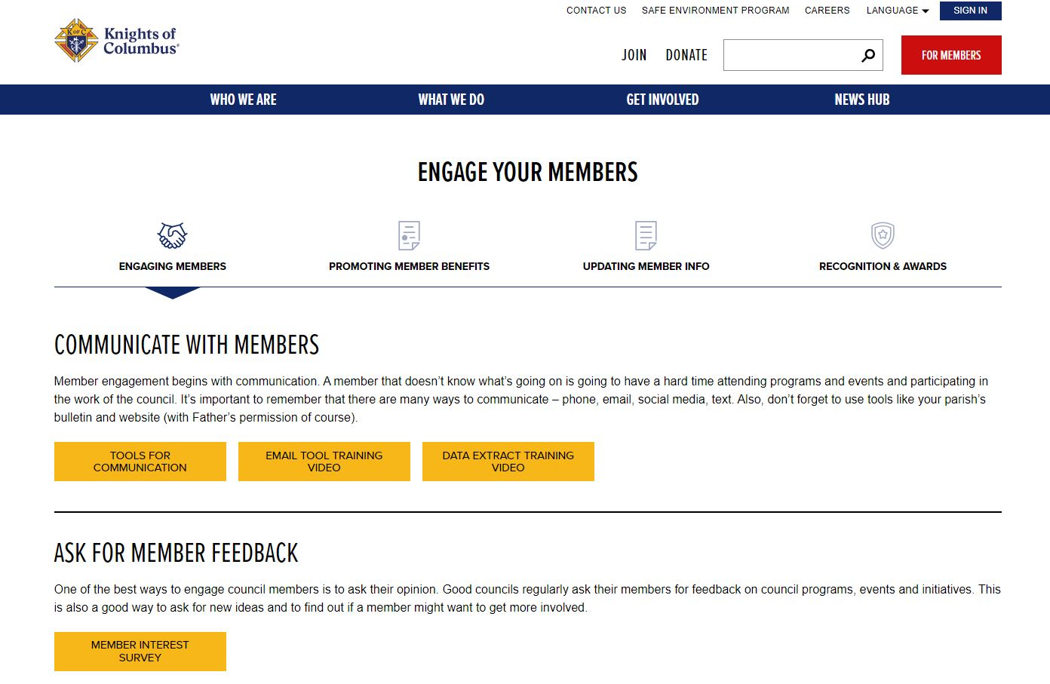
Engaging Your Members Tab Aids the Council Officers and District Deputies ENGAGE your Membership! An Engaged Member is an ACTIVE MEMBER and a RECRUITER!
Richard Gallant | District Deputy | Webmaster | Convention Registration | 4th Degree Exemplar
FloridaKnightsofColumbus@gmail.com | 561.707.5973

Slide 71
Richard Gallant | District Deputy | Webmaster | Convention Registration | 4th Degree Exemplar
FloridaKnightsofColumbus@gmail.com | 561.707.5973

Slide 72
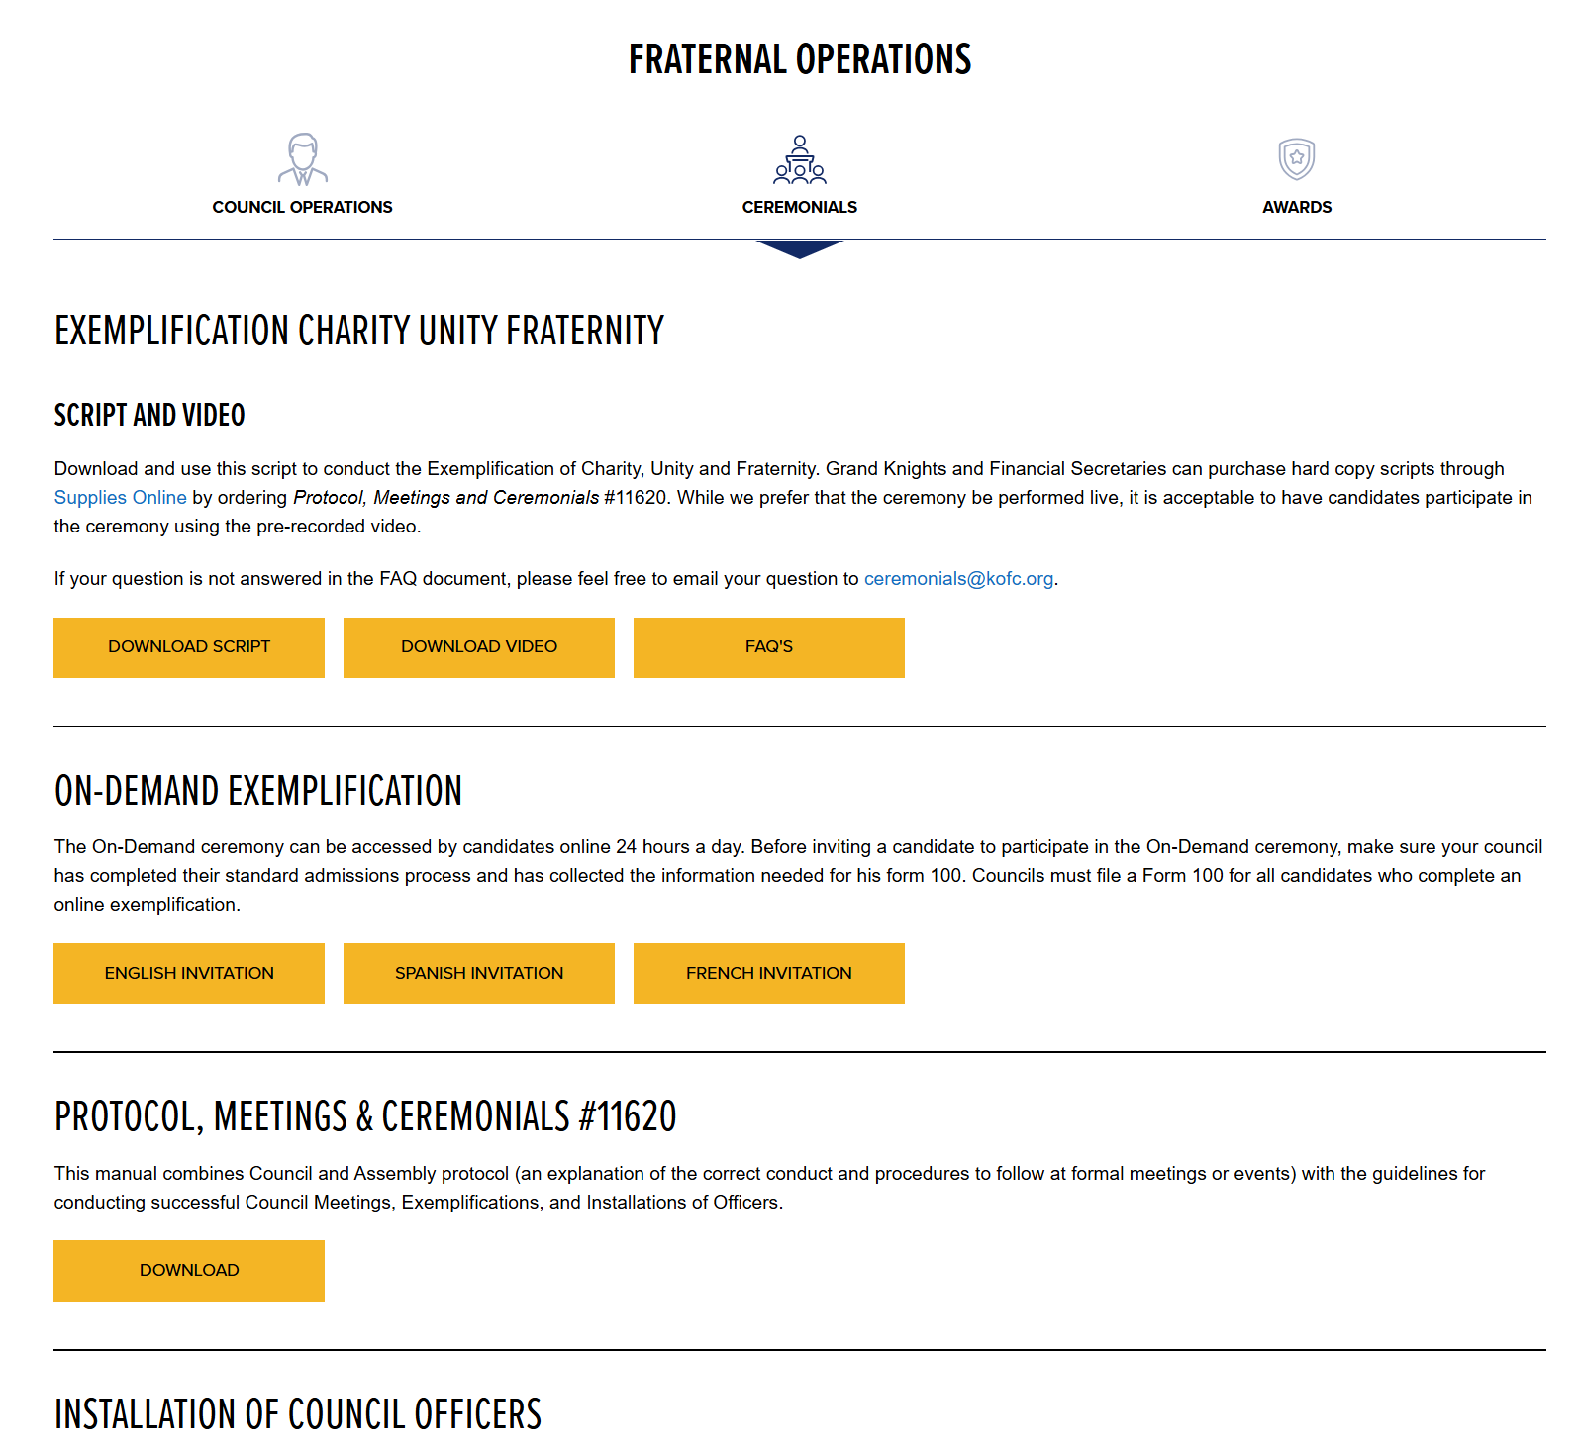
Ceremonial Resources including Scripts and Videos are Available Here
In English, Spanish and French
​
Richard Gallant | District Deputy | Webmaster | Convention Registration | 4th Degree Exemplar
FloridaKnightsofColumbus@gmail.com | 561.707.5973

Slide 73
A Bonus!!!
Richard Gallant | District Deputy | Webmaster | Convention Registration | 4th Degree Exemplar
FloridaKnightsofColumbus@gmail.com | 561.707.5973

Slide 74
Florida State Council Membership Roster
Upload File Name
YearMonthDayCouncilNumber
20241203Council12345
Make sure your councils know this!!!
Richard Gallant | District Deputy | Webmaster | Convention Registration | 4th Degree Exemplar
FloridaKnightsofColumbus@gmail.com | 561.707.5973

Slide 75
Live Demonstration and Questions
Richard Gallant | District Deputy | Webmaster | Convention Registration | 4th Degree Exemplar
FloridaKnightsofColumbus@gmail.com | 561.707.5973

Slide 76
Thank You
Richard Gallant | District Deputy | Webmaster | Convention Registration | 4th Degree Exemplar
FloridaKnightsofColumbus@gmail.com | 561.707.5973

